Slide 1
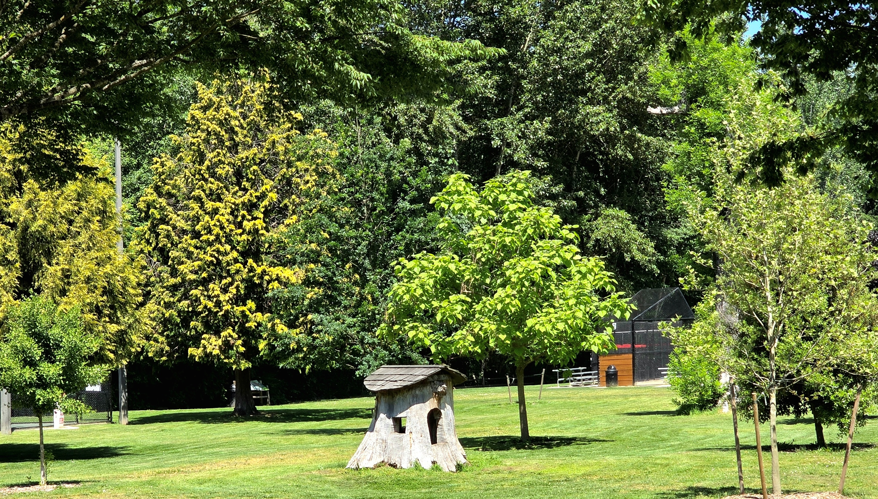
2026 UFMP Vision and Goals
Planning Commission Update
August 13, 2026
Anna Heckman, Environmental Program Coordinator
Board Certified Master Arborist, Certified Urban and Community Forester

Slide 2
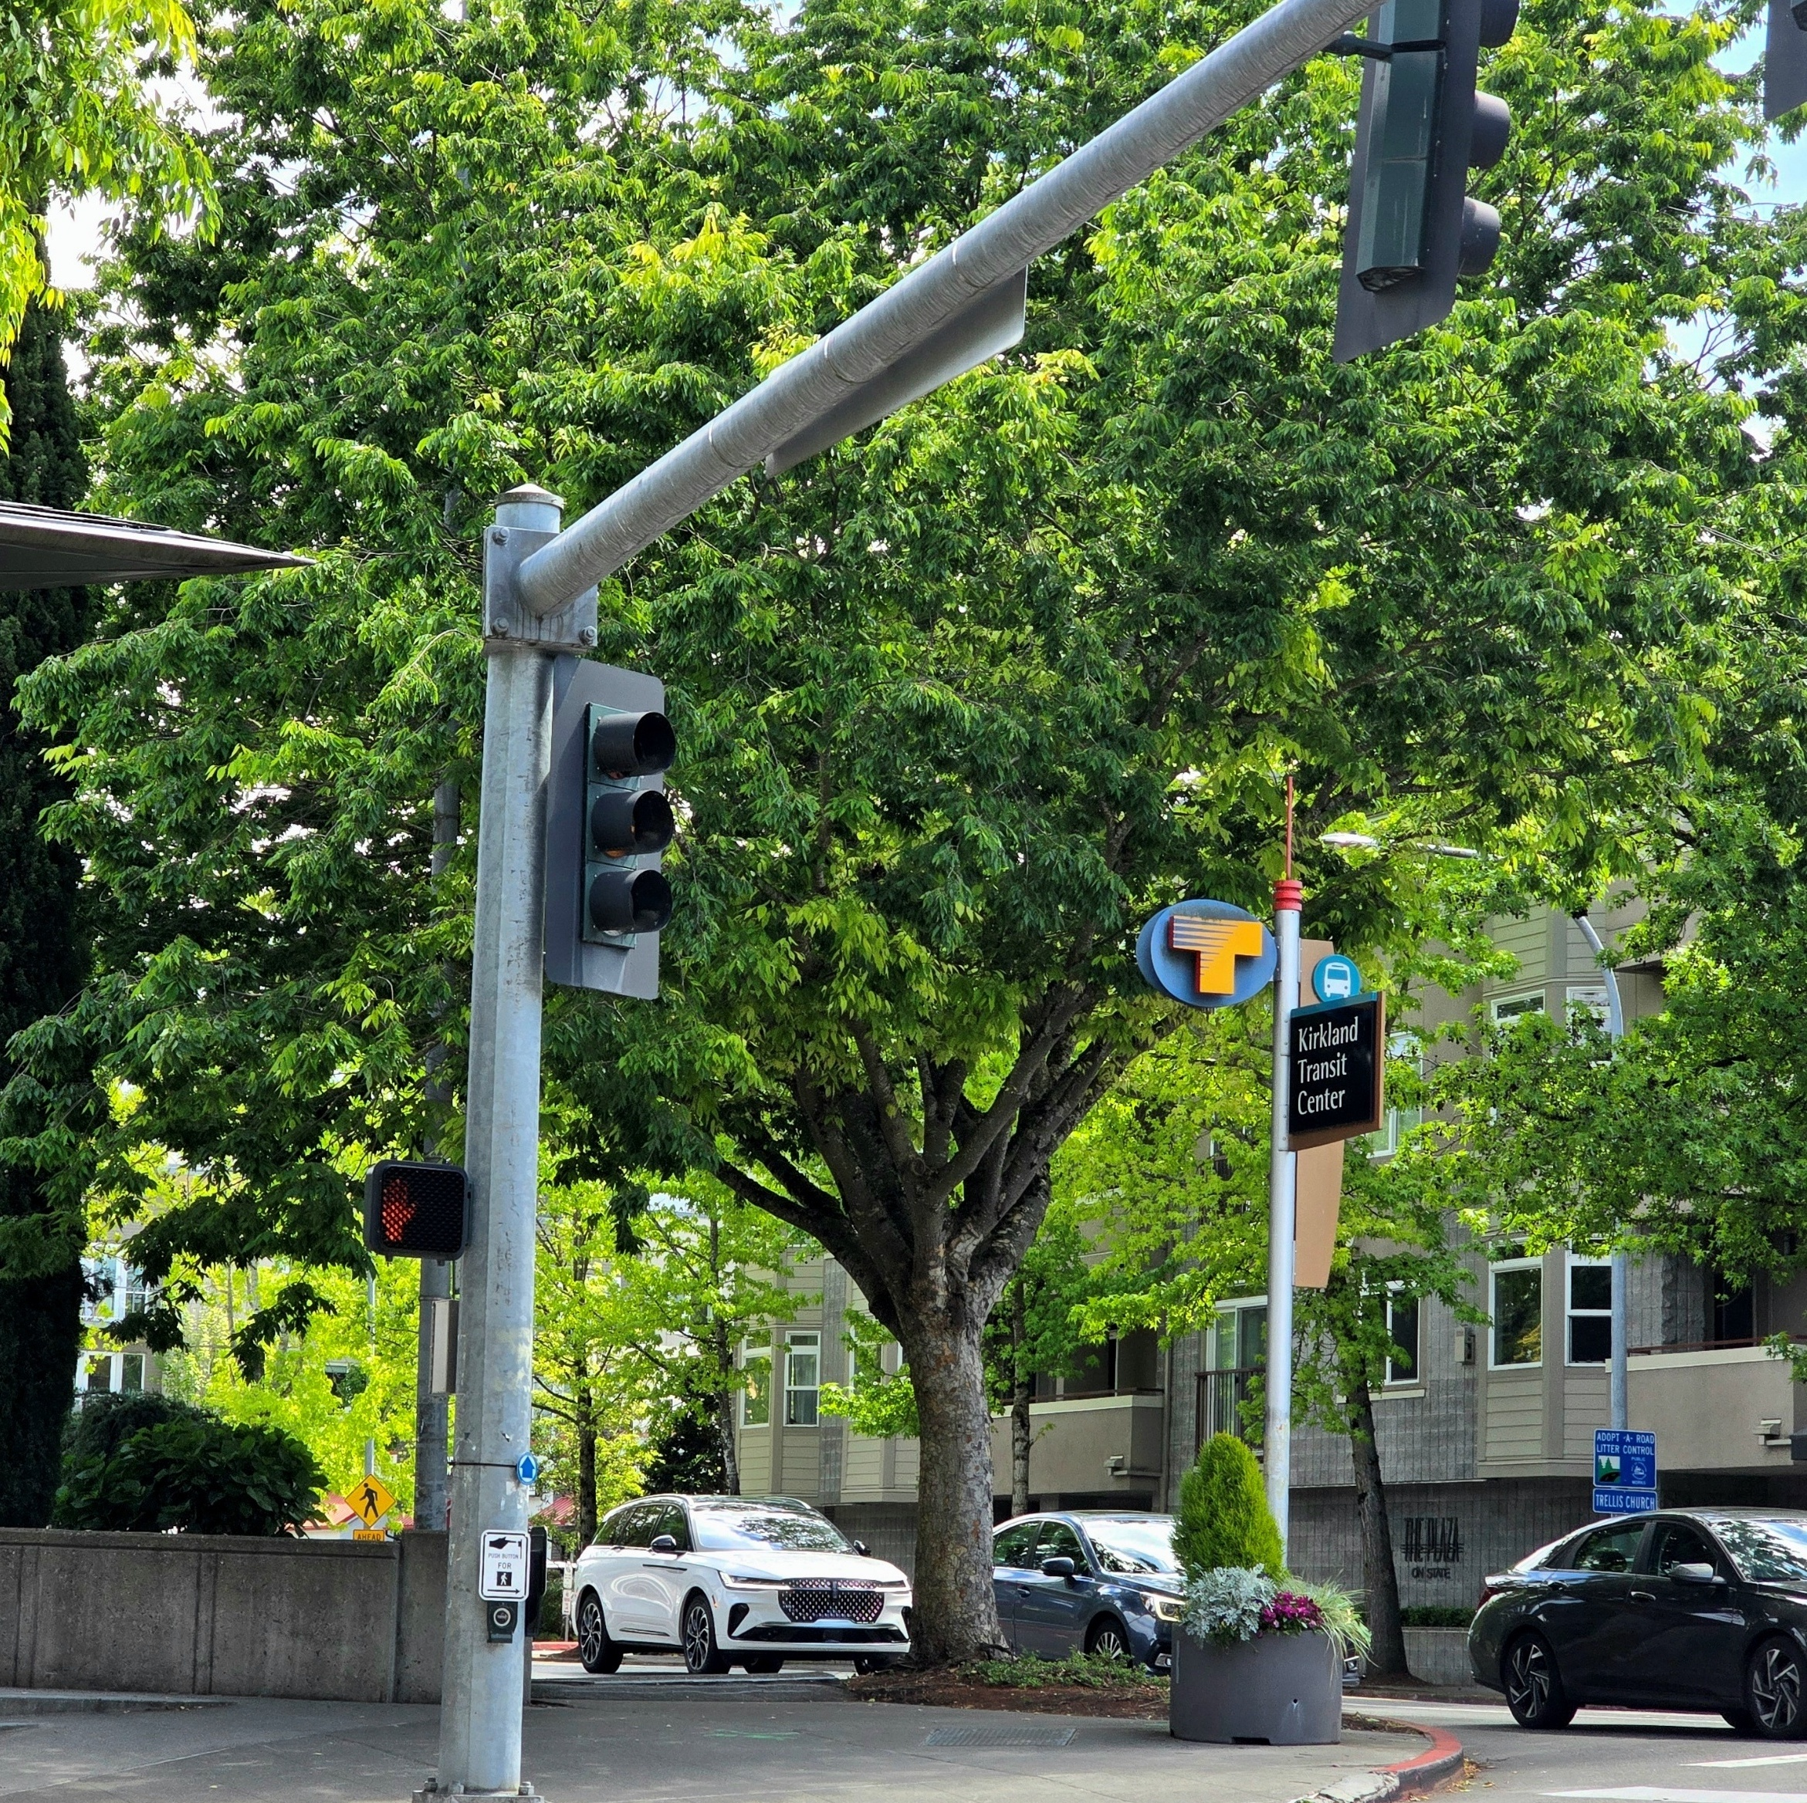
Agenda
Community tree survey
Vision statement
Guiding principles
Goals with research and metrics for each
Example lay out

Slide 3
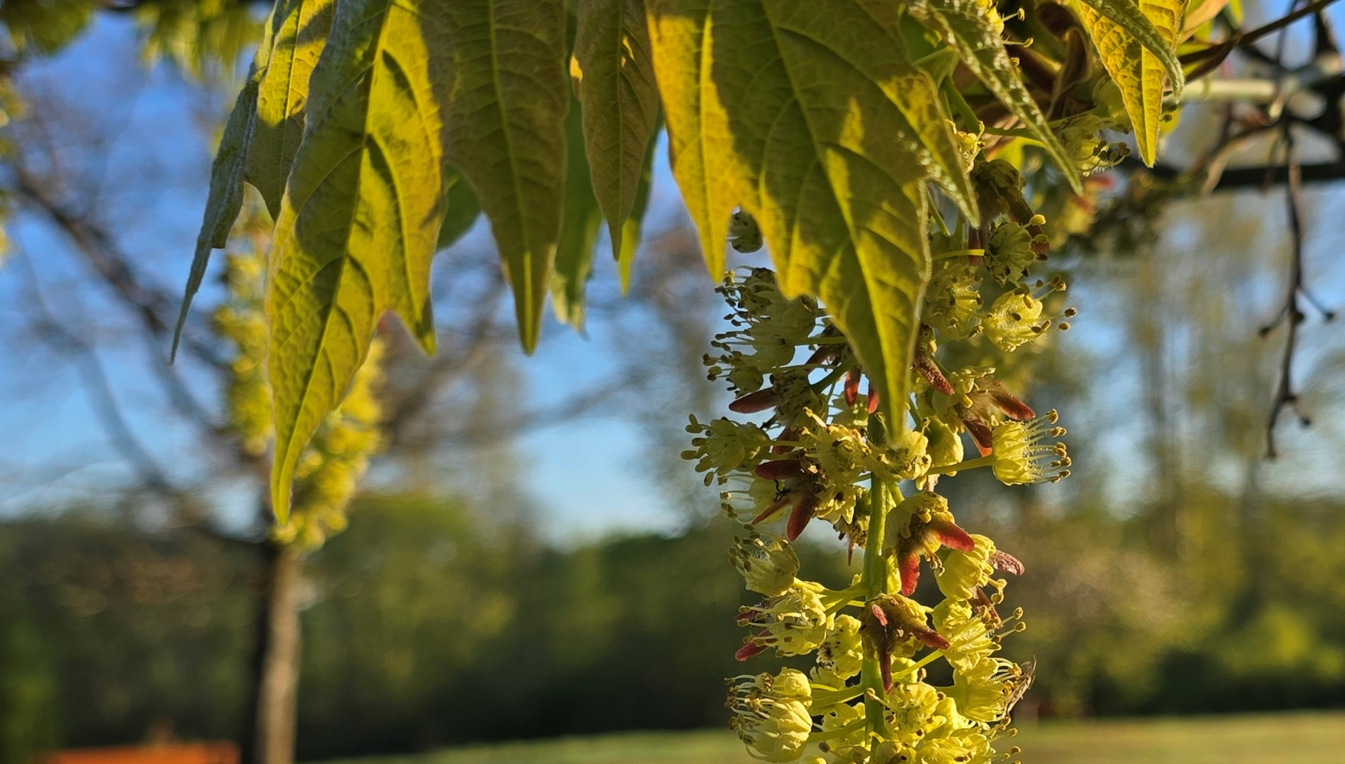
Community Tree Survey and Public Comments
Results from ~600 respondents, most have knowledge of trees and/or have been directly impacted by trees or Kirkland’s permit process.
Respondents have a split opinion between private property rights vs protecting trees as a community asset.
Higher canopy cover is a priority goal.
Concerns expressed regarding how canopy retention and increasing density is possible.
Many recommendations provided on how to improve tree canopy and public tree health and programs for private property trees.
Some community members perceive unfairness between development and non-development tree removal.
Many requests to increase staff and resources for urban forestry programs and public tree care.
Requests and recommendations for the City to lead by example with tree removal, pruning and management.
Public comments from Finn Hill Neighborhood Alliance and from MBAKS expressed similar concerns and recommendations that will be addressed in the objectives and work plans.

Slide 4
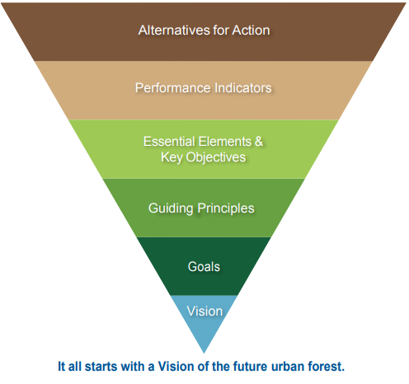
Create a new UFMP using the SSP framework and UFMP Research
Data-based Decision making
Staff Urban Forestry Team
2026 Community Urban Forest Survey
Council Review and Input
Industry UFMP Guidance, BMP’s and Research
2044 Comprehensive Plan
and Community Outreach

Slide 5
Draft Vision Statement
Kirkland’s urban forest is vital green infrastructure that is essential for a healthy, resilient, and livable city. The urban forest is a defining feature of Kirkland’s identity. Through the City government and community’s shared stewardship of trees and forested areas, Kirkland’s urban forest will strengthen the community’s resilience to climate change, support urban biodiversity, provide lasting social and economic benefits and improve the health and wellbeing of community members as Kirkland’s population grows.

Slide 6
Draft Guiding Principles
Ecological Resilience:
Ensure that forested natural areas and trees in Kirkland are managed to conserve and improve critical areas and natural habitats, protect the health of local waterways, and are able to withstand, adapt to, or recover from the increasing complexity and intensity of disturbances in the urban environment at both regional and local scales
Livable Communities:
Ensure Kirkland’s urban forest is designed and managed to encourage and improve the physical and mental health and wellbeing of the community and that urban forestry can be adapted to meet the community’s needs within different land use areas in a welcoming, equitable and inclusive manner.
Transparency, and Equilibrium:
Ensure community programs, projects, and policies identify, communicate, and balance urban forestry priorities with regional housing and employment commitments, other City policies, legal requirements, and/or budget limitations.
Science, Technology, and Innovation:
Invest in, utilize and promote research, science, technology and industry standards to make informed decisions and create innovative solutions to challenges using both Best Available Science (BAS) and Best Management Practices (BMP).

Slide 7
Goal 1: Build and protect a healthy and resilient urban forest as it adapts, recovers, and grows through increasing urban development and climatic stress

Slide 8
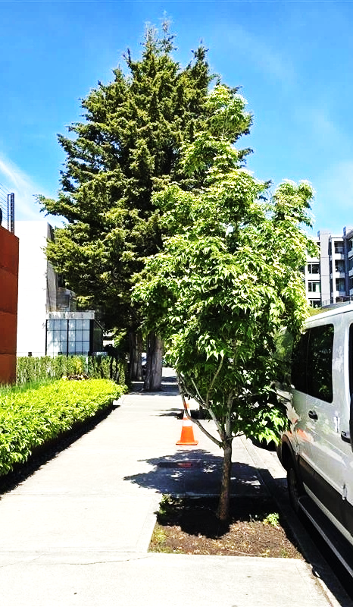
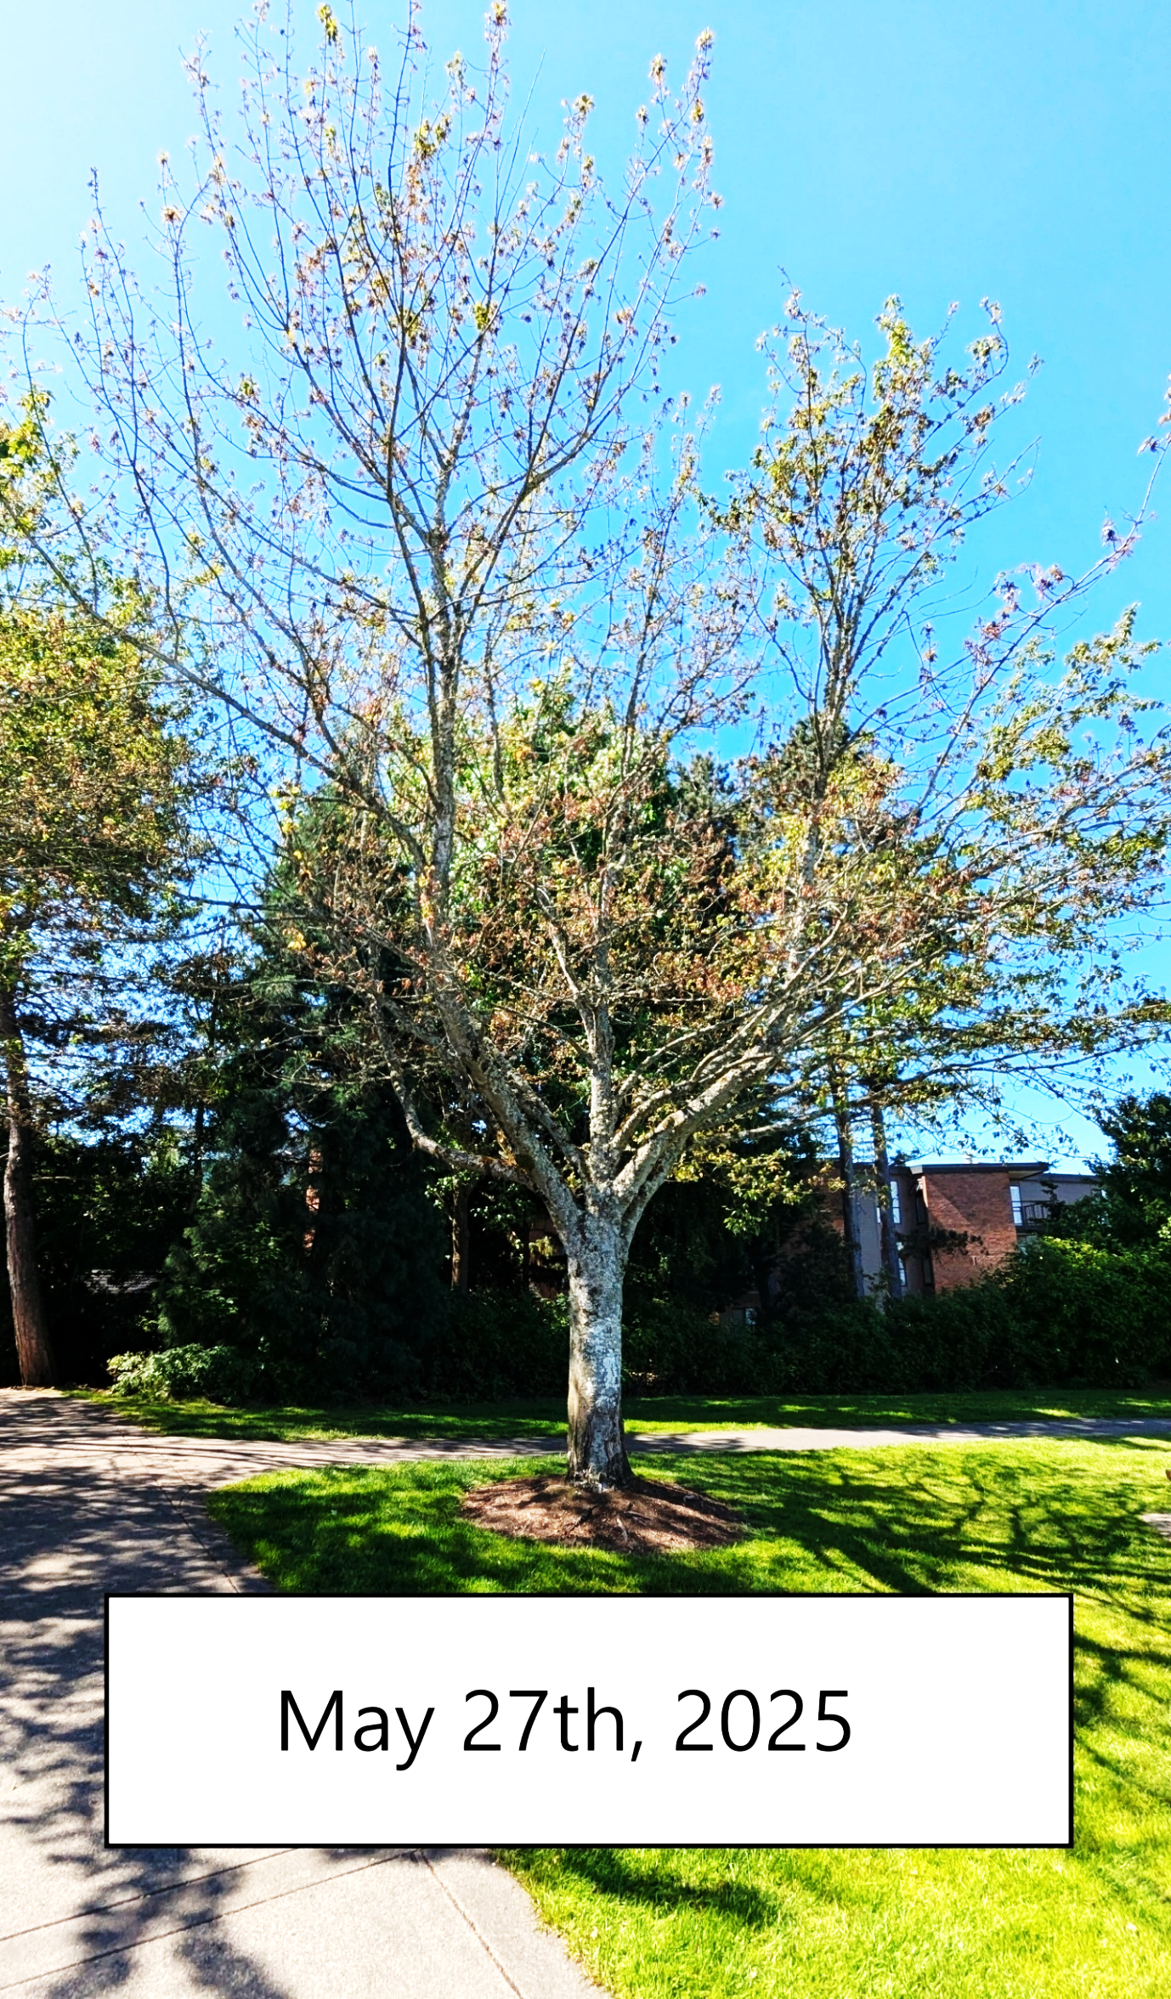
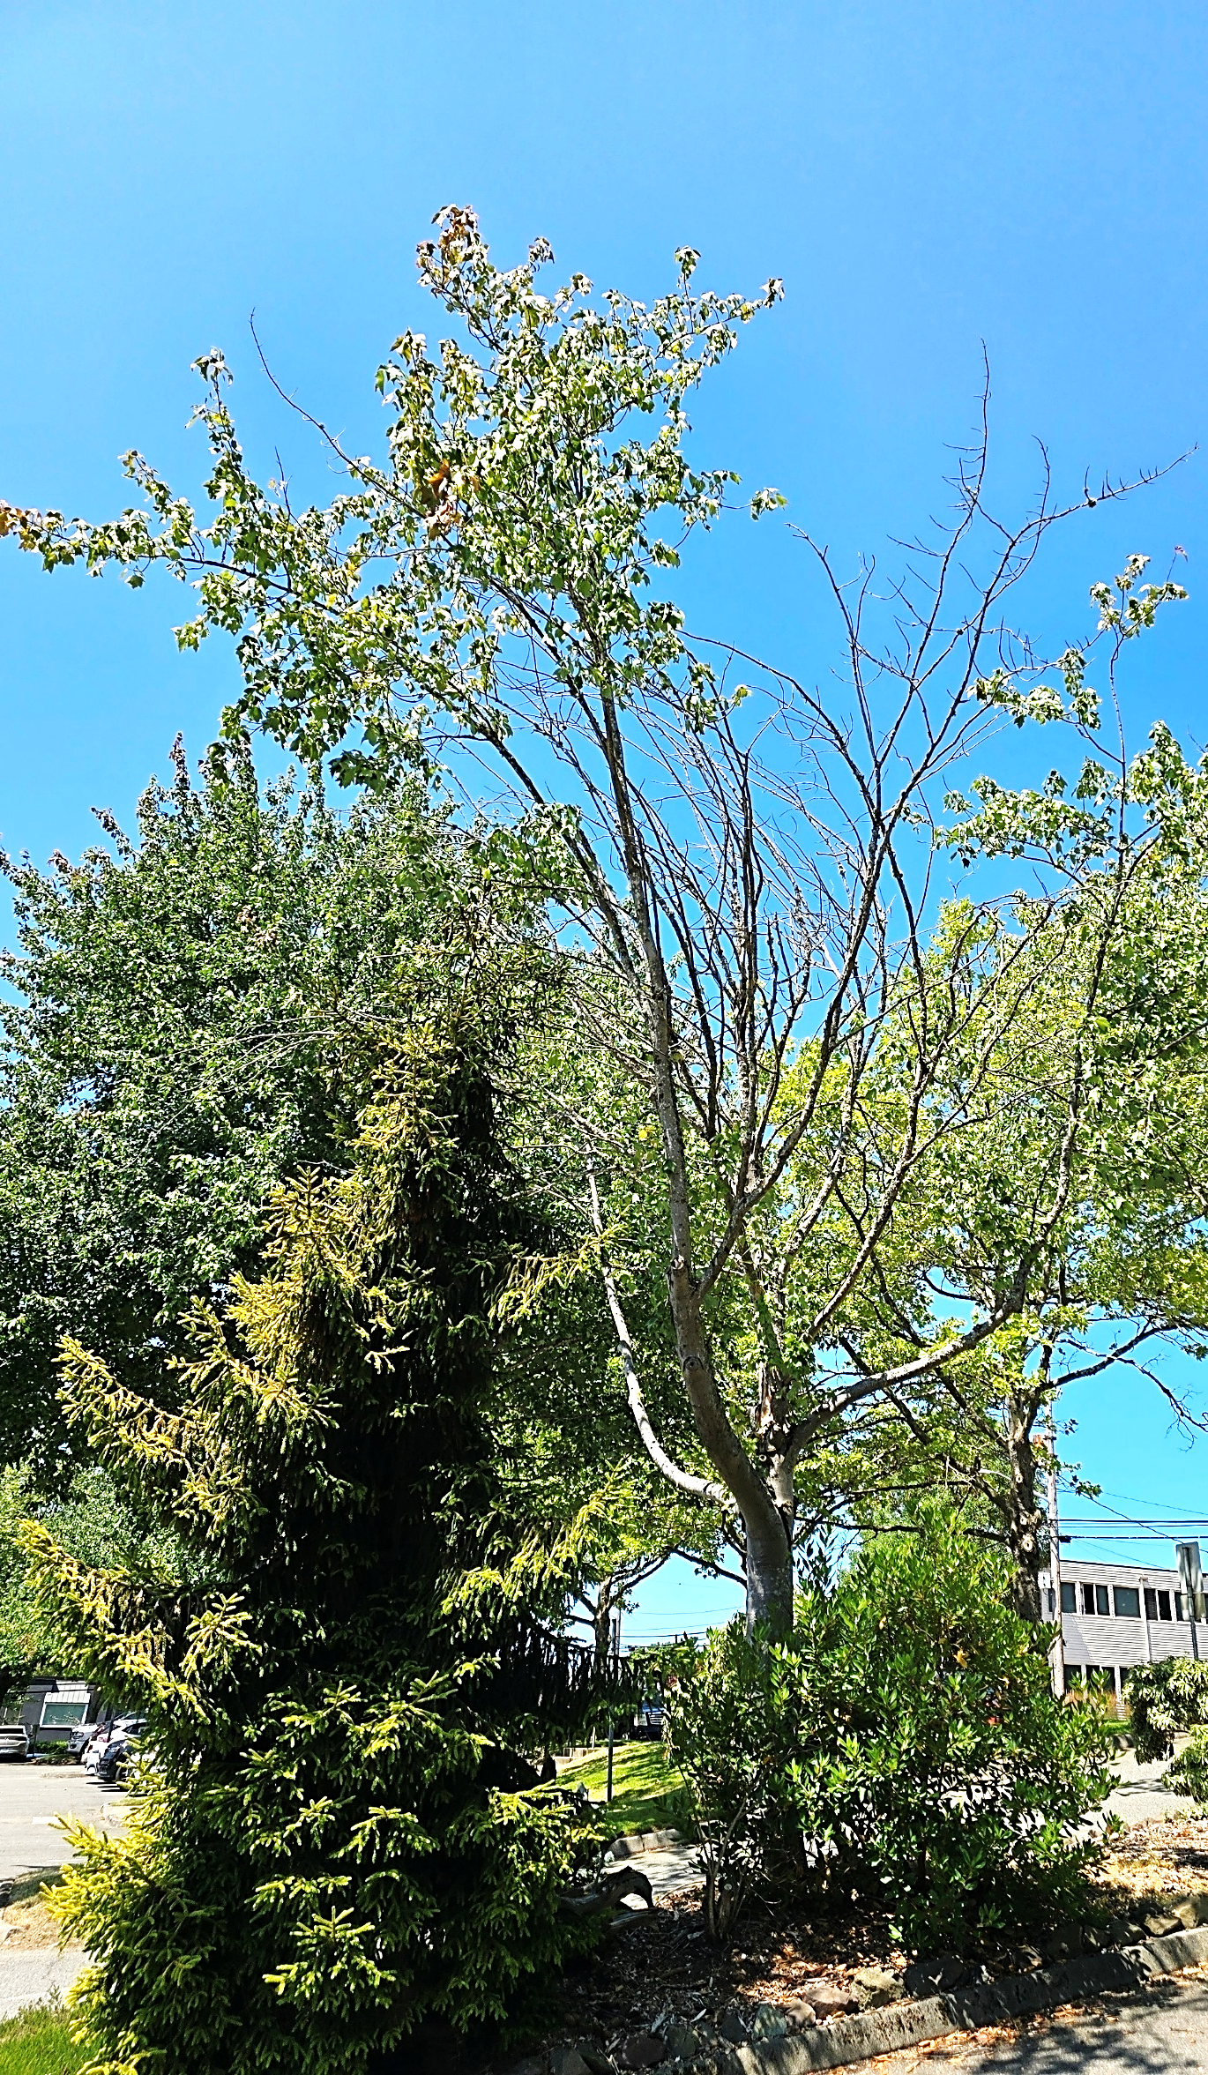

Slide 9
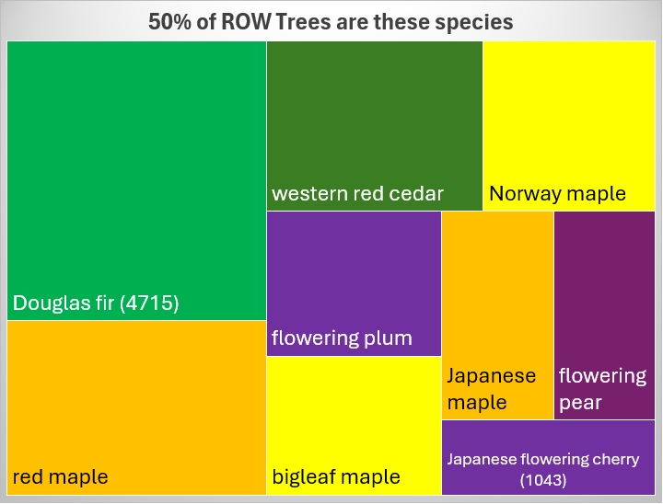
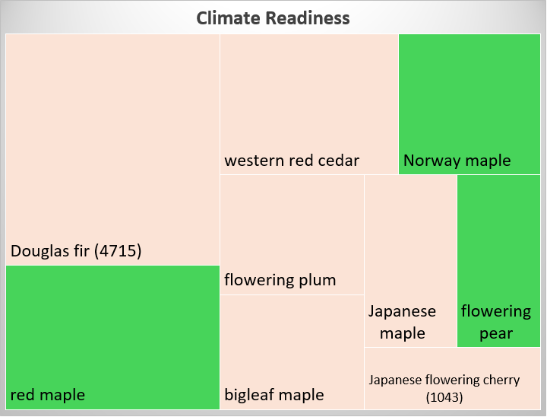
Tree Species Diversity

Slide 10
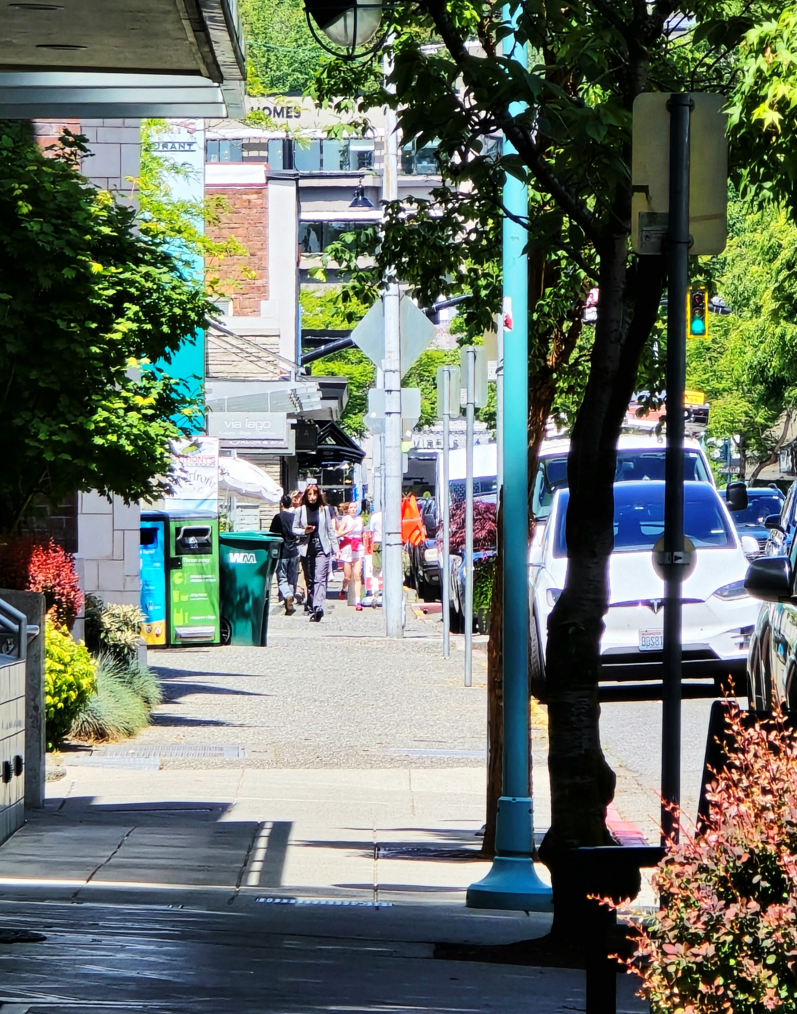
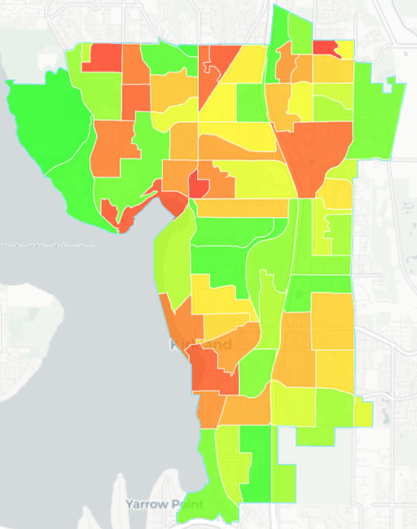
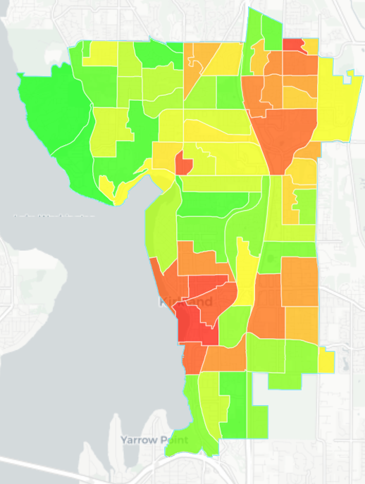
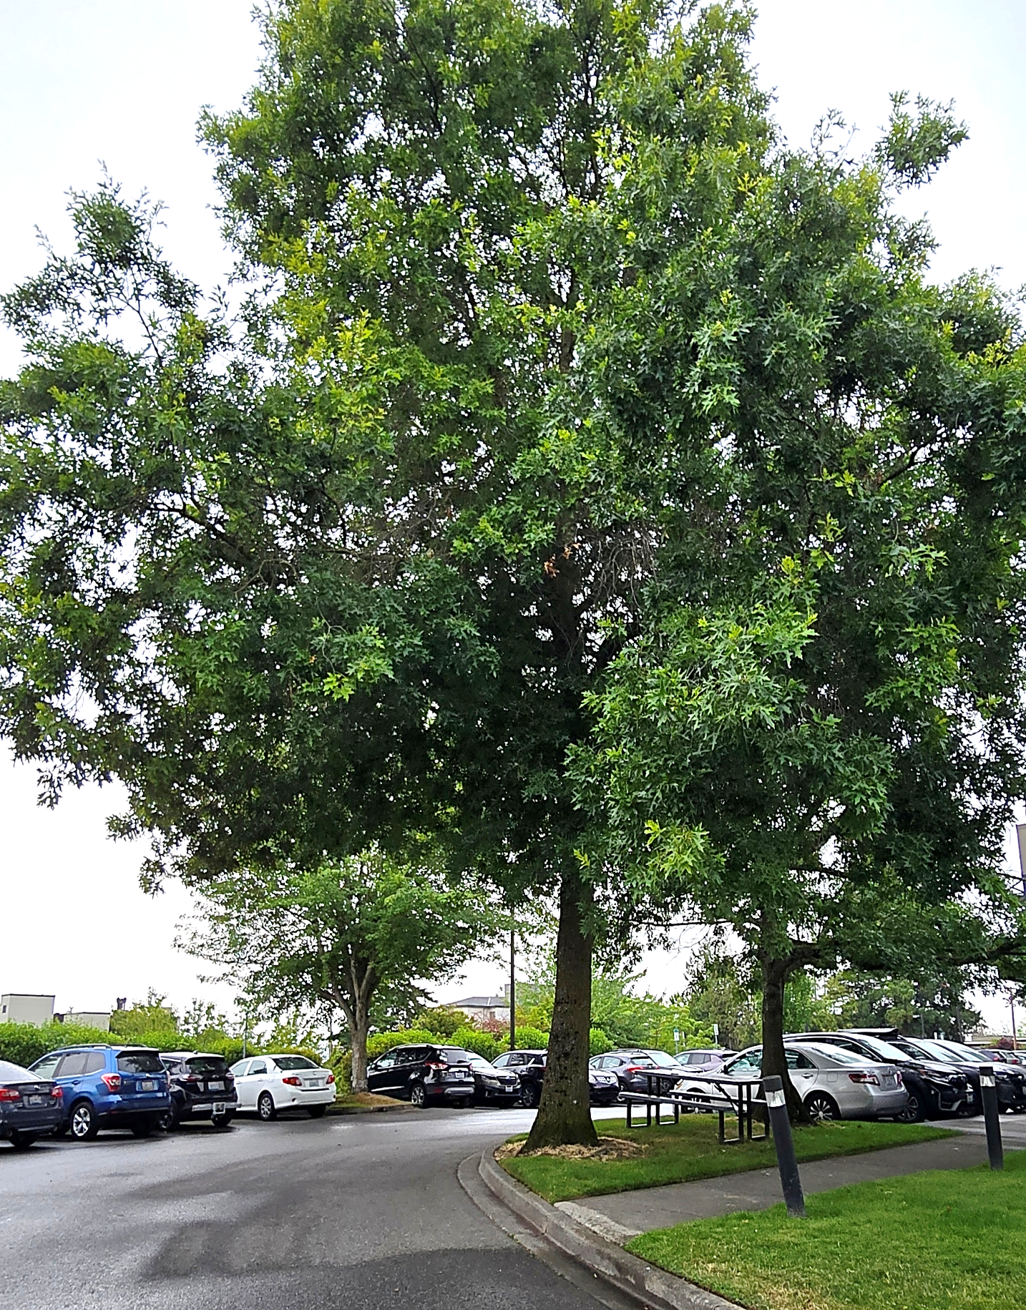
Goal 2: Maximize the benefits urban forests can provide as an essential community asset and leverage these benefits to pursue the goals of other City strategic plans
Low canopy cover and high stormwater reduction potential
King Conservation District Urban Forest Health:
https://pg-cloud.com/KingCD-Cities/
Low canopy cover and high heat island reduction potential
Notes:
WA DNR Urban Forestry American Forests Equity Map: https://www.treeequityscore.org/analyzer/washington/map
King Conservation District Urban Forest Health/ PlanIT Geo: https://pg-cloud.com/KingCD-Cities/
USDA Forest Service I Tree Eco Benefit Calculators: https://www.itreetools.org/

Slide 11
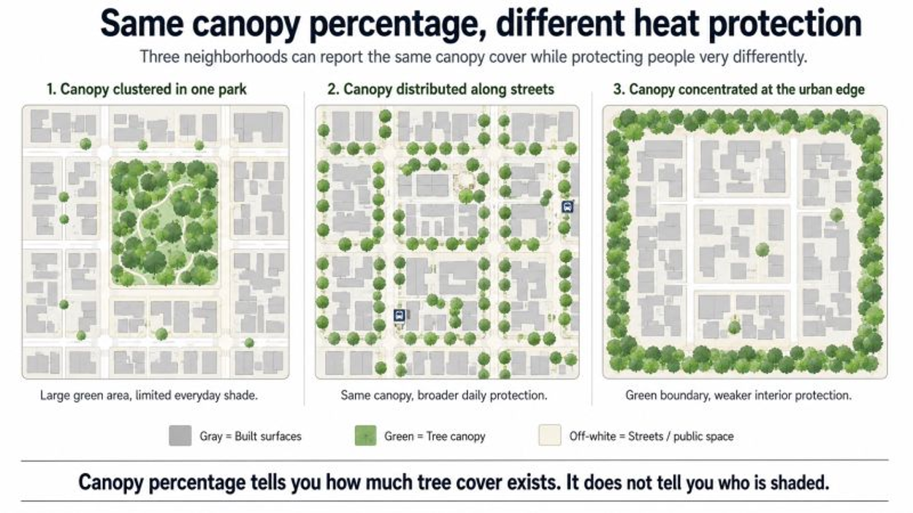
https://www.linkedin.com/posts/dionkucera_urbanheat-urbanforestry-gis-activity-7478181643522875392-kHnN

Slide 12
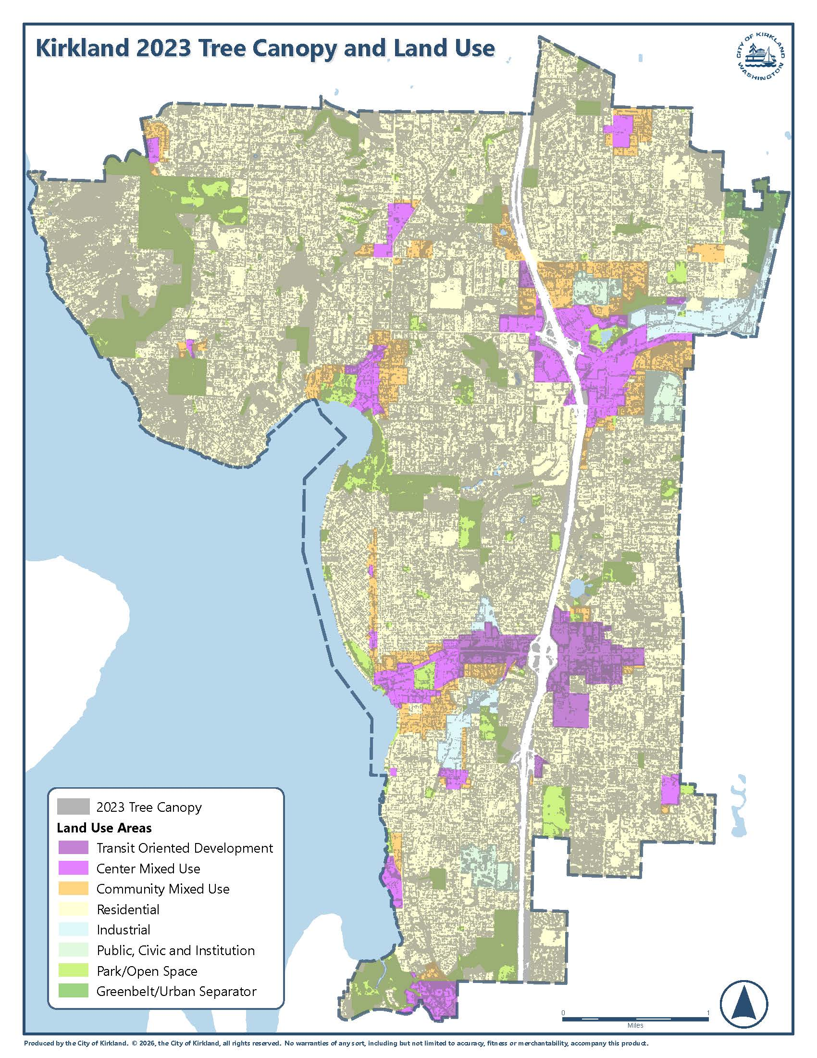
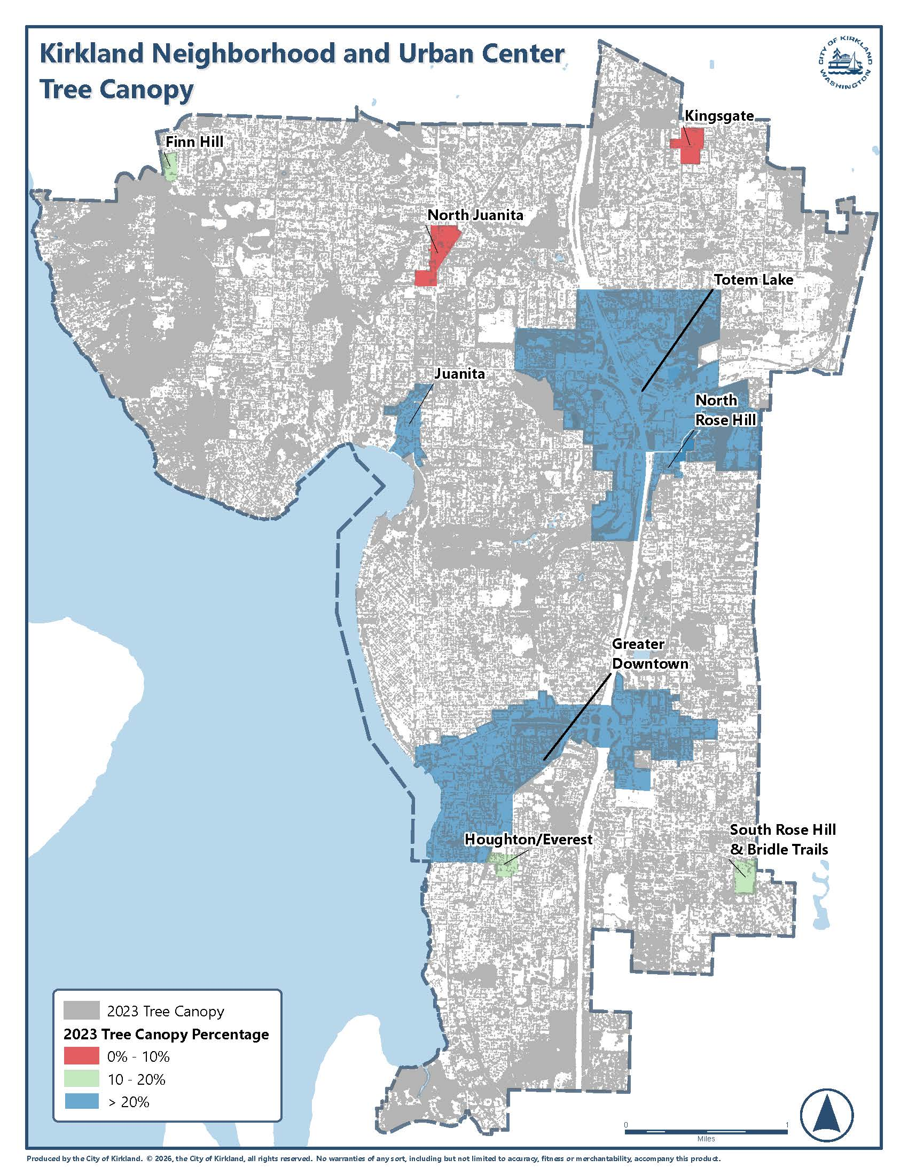
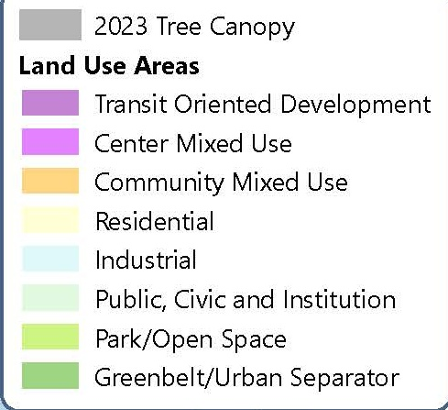
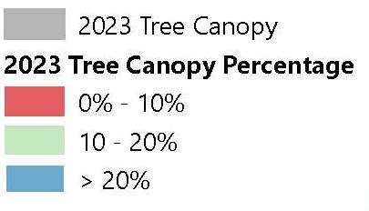
Goal 3: Build and maintain an average canopy cover of 40%
16%
5%
9%
30%
23%
25%
23%
27%
18%
19%
13%
34%
39%
25%
38%
78%
85%

Slide 13
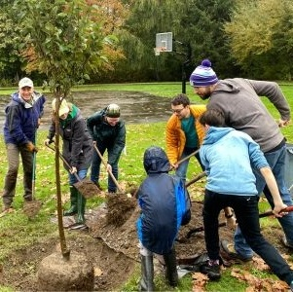
Goal 4
Build public programs to educate and empower community members to participate in diverse urban forestry engagement opportunities and to increase community connectivity and understanding of Kirkland’s urban forest

Slide 14
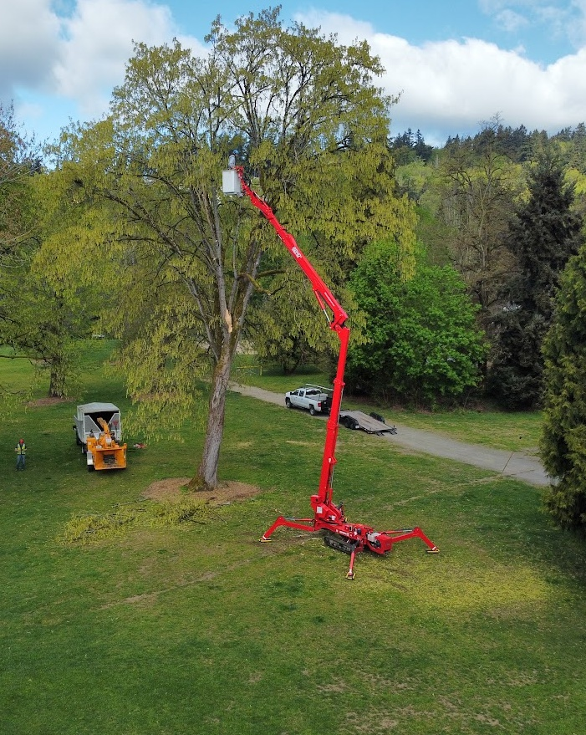
Goal 5
Build programmatic capacity to maintain and grow Kirkland’s urban forestry assets in a safe, efficient, and sustainable manner

Slide 15
Metrics for Goals 4 and 5 = Industry Standards
    Tree City USA Management: Tree department or board
    Policy: Public tree care ordinance
                Investment: Forestry Budget
                Celebration: Arbor day observance and proclamation
    TCUSA Growth Awards Building the team
    Measuring trees and forests
                Planning the work
                Performing the work
      The community framework
    Urban and Community Leadership
    Forestry Society Governance and planning
    Management
    Community engagement
    Sustainable Forestry Institute 16 objectives
2014 and 2024 Municipal Survey and Regional comparisons
Collaboration
Volunteers
Outreach
Awareness
Education
Budgets
Staff
Training
Planting trees
Maintaining trees
Tree Risk Management
Recycling and Reuse
Protecting Trees
Natural Areas
Community outreach program
Partnerships and collaborations
Public Relations

Slide 16
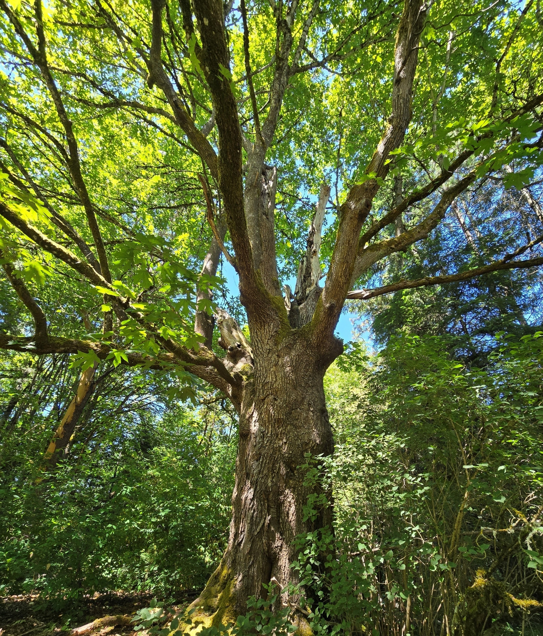
Questions and Feedback?
Does PC have any additional questions for staff to analyze or consider with development of 20- year objectives and action items in the UFMP update?
Does PC have feedback on the draft UFMP vision statement, guiding principles, and/or goals?

Slide 17
What To Expect:
Create a new UFMP using the SSP framework.
Develop a 6YWP using updated standards and goals.
Project Phase/Staff Tasks
final UFMP,
6YWP – select measurable actions to meet objectives that should be prioritized over the next 6 years
draft UFMP,
create measurable objectives to meet goals, define actions to meet objectives
data gathering,
literature review,
project scope and plan
data analysis,
community survey,
draft vision and goals
Jan
March
May
July
Oct
Dec
Jan
Council #1
Project Scope
Council #2 Research Results
Vision and Goals
Council #4
Final UFMP
Draft 6YWP
Council #3
Draft UFMP
Council #5
Adoption
Council/
PC Updates
PC #1
Project Plan
PC #2
Draft UFMP
PC #3
Draft 6YWP

Slide 18
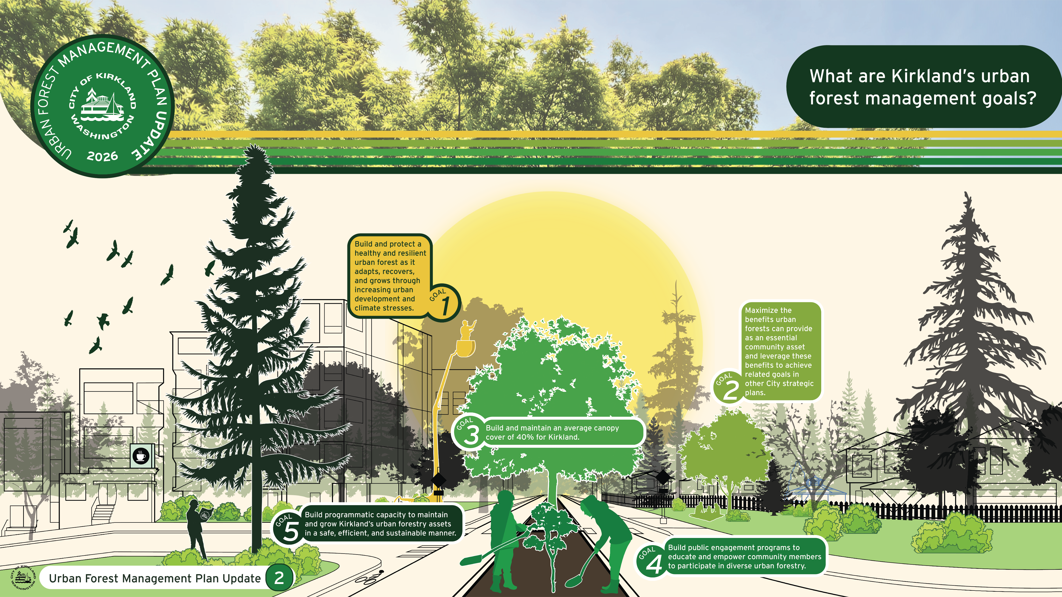

Slide 19
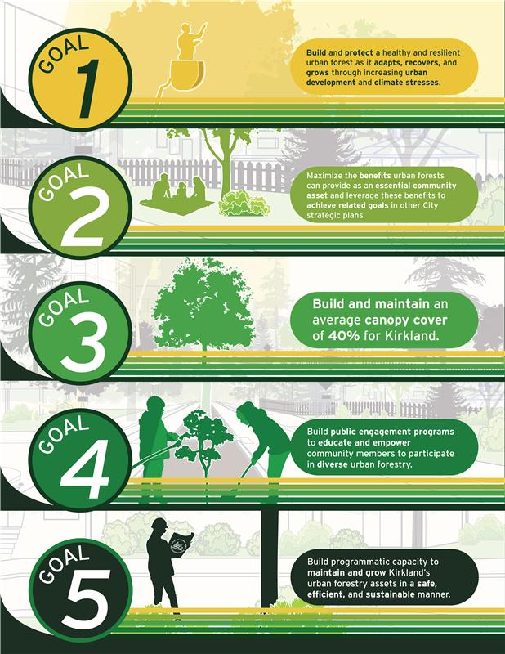

Slide 20
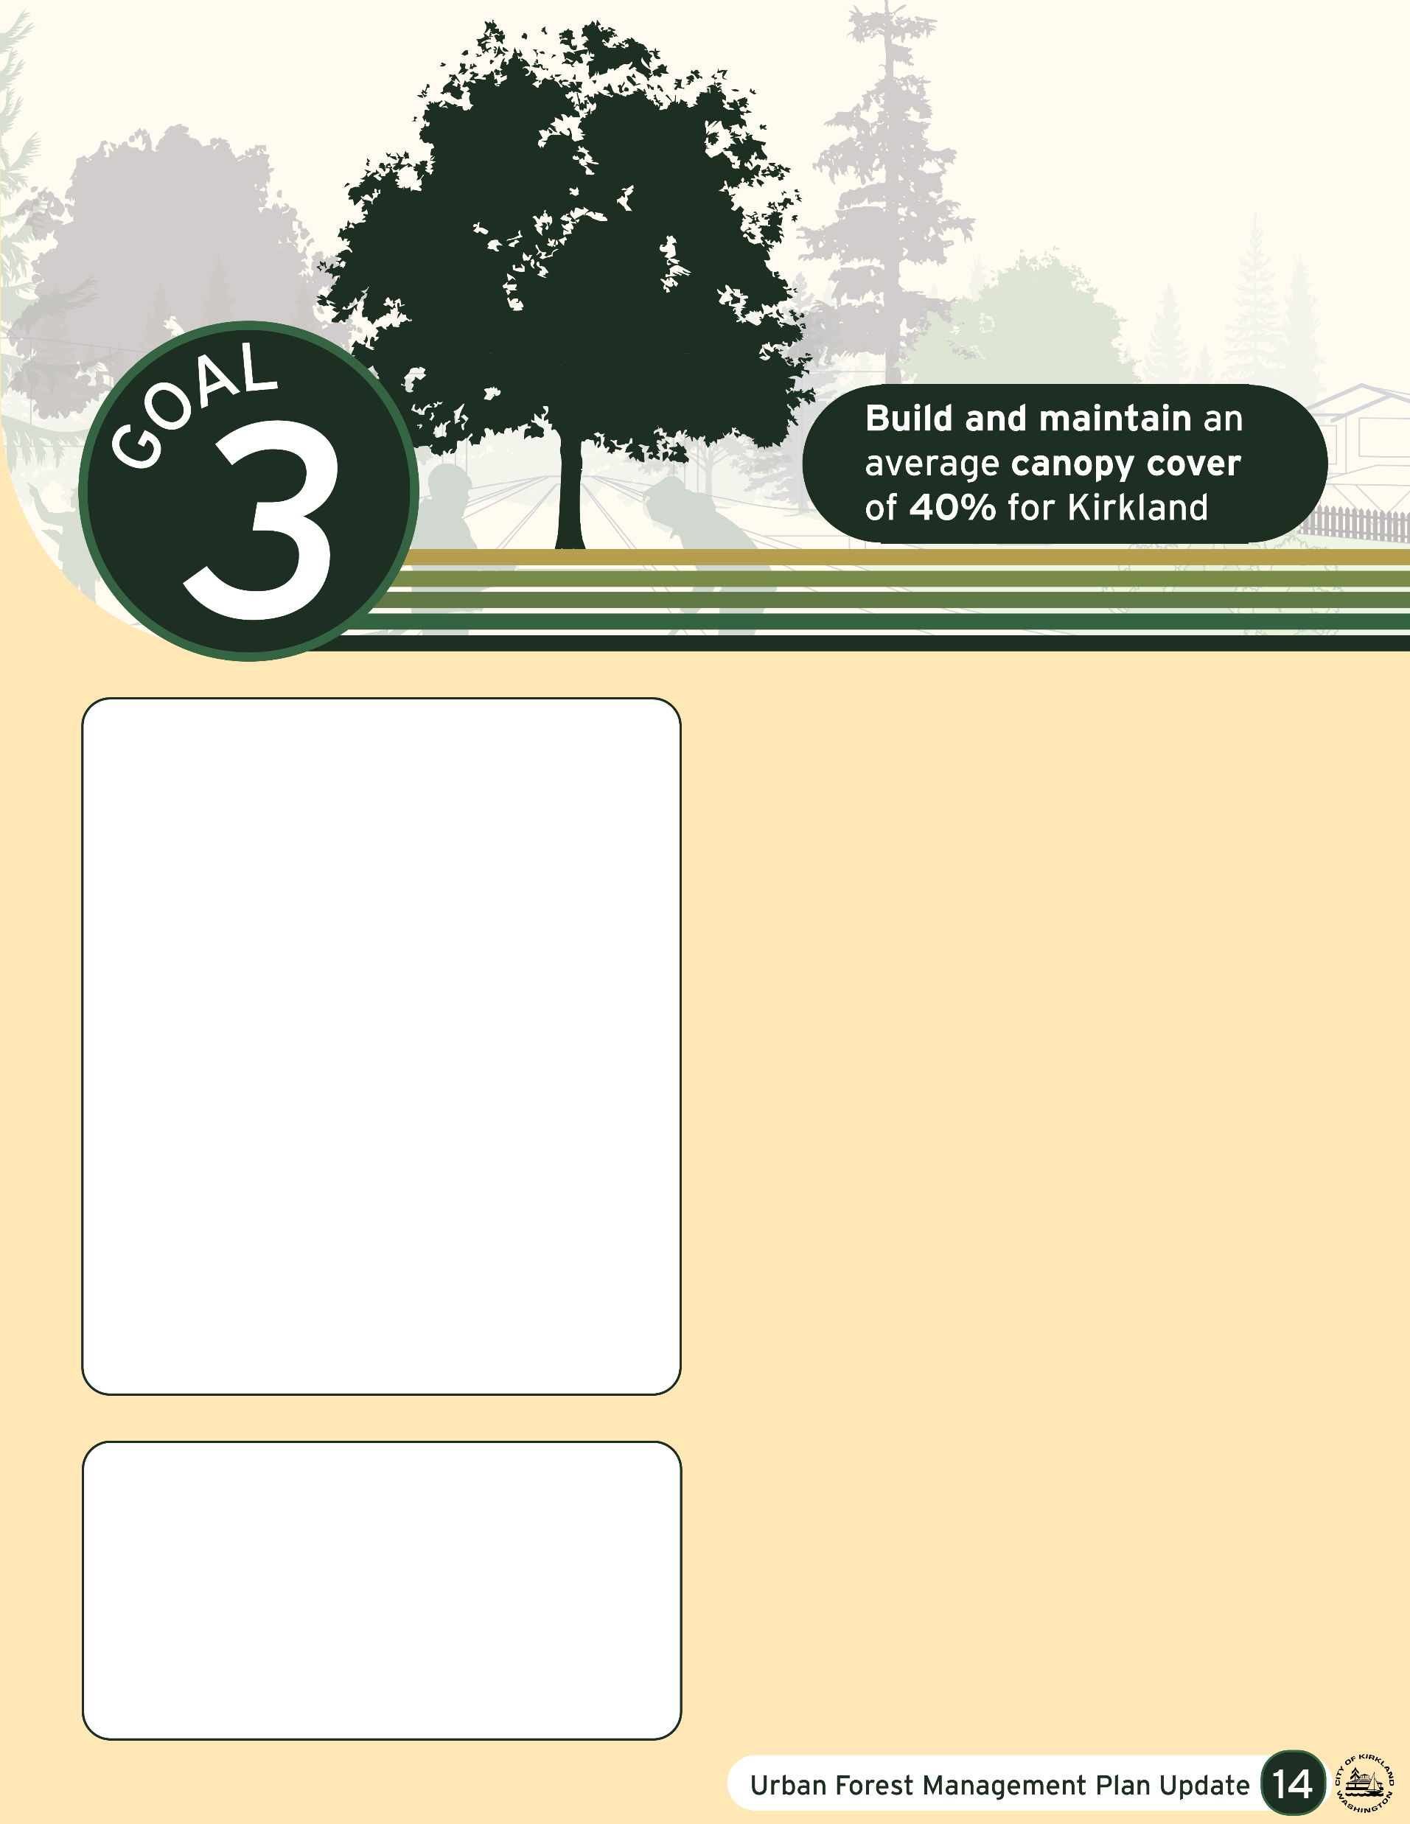
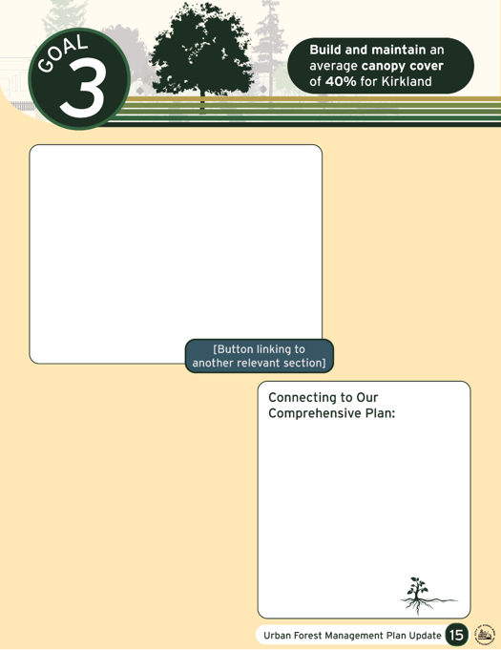
What is Kirkland’s status?
(What do we have)
Why is this important to Kirkland?
(What do we want?)
Links to Associated Policy
Industry Standards/ BMP’s

Slide 21
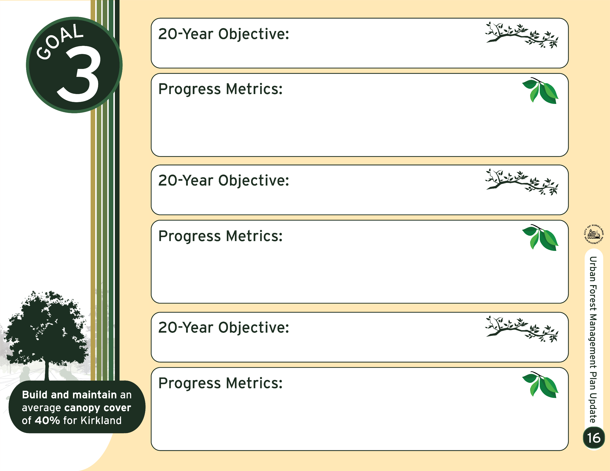
Incorporates Guiding Principles and Focus areas.
How do we get what we want
Written for all departments to be able to use
Written to allow multiple pathways for success
Standard documented and comparisons may adapt over time with improvements in the industry and available data

Slide 22
