Slide 1
2026 STATE OF THE URBAN FOREST & UFMP UPDATE
Planning Commission Meeting
April 9, 2026
Anna Heckman, Environmental Program Coordinator
Board Certified Master Arborist, Certified Urban and Community Forester
Notes:
Three objectives… 1 talk about the existing urban forest where we have come in just over a decade.
New research (NOT A CASE STUDY) that will inform our future plans
What to expect over the next year.
This is council level decision making but it is Information that we want PC to consider important information so you can speak with Community members -

Slide 2
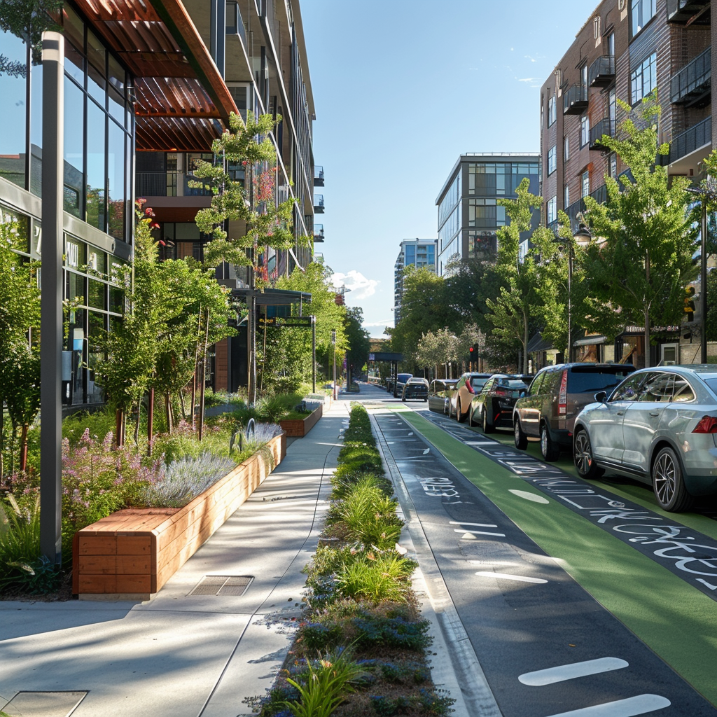
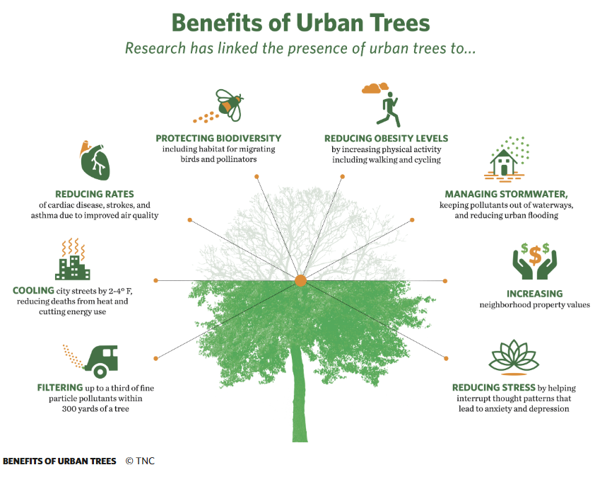
Urban Forests Matter!
Human Health:
  Reduce urban heat island effects
  Dissipate and absorb air pollutants
  Improve mental health
Water Quality and Wildlife:
  Slows and cleans stormwater runoff
  Reduce soil erosion
  Habitat migration corridors
  Create quieter neighborhoods
Livable city:
  Canopy corelates with crime reduction
  Traffic calming and walkable streets
  Impact property values
  Increase business district productivity
Notes:
Direct and indirect benefits –
Storm water – 250K in benefits per year from our street trees. based on consultant program calculations
Some are not directly measurable – and do not have systems to connect to monetary value
https://www.nature.org/en-us/about-us/where-we-work/united-states/washington/stories-in-washington/voice-for-healthy-urban-trees/

Slide 3
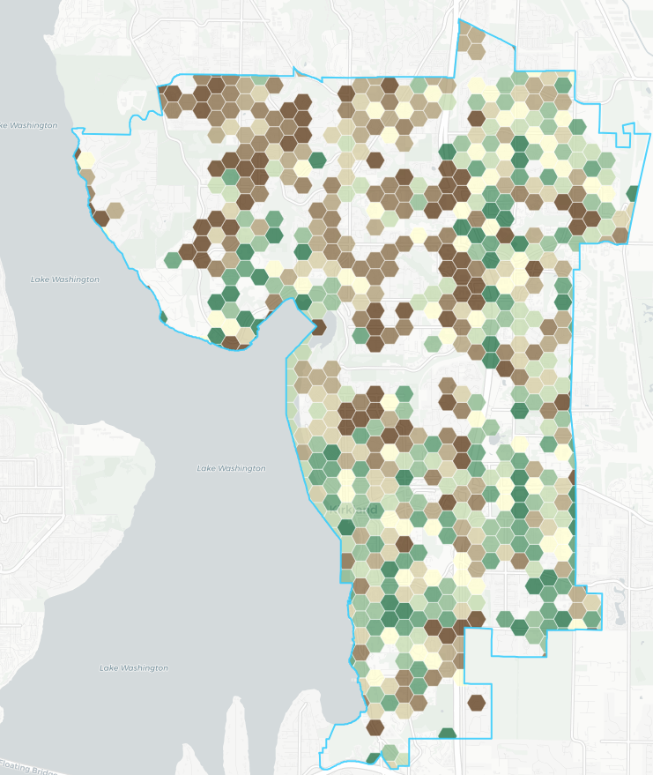
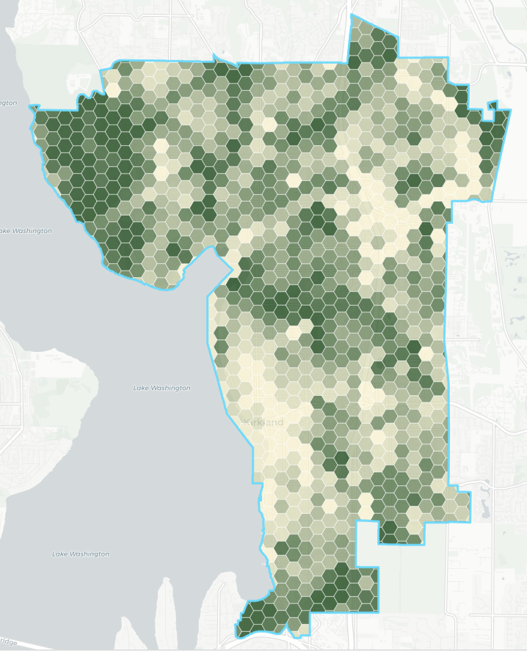
What makes a Healthy Urban Forest?
Beyond canopy cover
Distribution to provide benefits
Resiliency:
  Diversity in size, species
  Climate change and pests
Strong Urban and Community Forestry Program
  Proactive vs reactive management
  Manages trees as an asset vs. resource
  Storm, pest and climate preparedness
  Risk management
  Community engagement/ownership
Notes:
Canopy cover is only one part.
41% canopy to 37% canopy

Slide 4
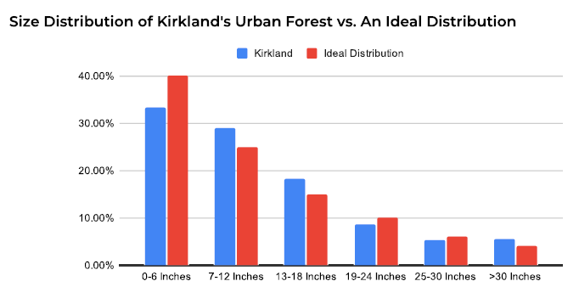
What makes a Healthy Urban Forest?
“
”
Notes:
Do we have a healthy urban forest? Size diversity is close.
“Ideal is a forest based assessment where all the small trees have potential to grow large
0=6 inch bucket looks good but that is still a few thousand trees needed to be planted over the next 5 years to make up the difference.
Each “bucket” of trees takes 10-20 years to reach the next size.
We have a good number of old large trees but more provide greater benefits
We should be planting many more trees now to increase the <6” bucket.

Slide 5
What makes a Healthy Urban Forest?
Other
Maple
Beyond canopy cover
Distribution to provide benefits
Resiliency:
  Diversity in size, species
  Climate change and pests
Strong Urban and Community Forestry Program
  Proactive vs reactive management
  Manages trees as an asset vs. resource
  Storm, pest and climate preparedness
  Risk management
  Community engagement/ownership
Apple
Dogwood
Douglas Fir
Poplar
Pear
Pine
Alder
Cedar
Cherry/plum
Diversity of trees in Kirkland’s 2023 public tree inventory
Notes:
We have good species diversity for the PNW and good size distribution Note Douglas fir 6700 DF in the inventory (13%)
and add in Kirkland species (10 20 30 rule)
We don’t have to worry about threats like hurricanes, tornadoes, ice storms and west of the mountains, rarely fire, however we do have to worry about climate change – and pests.

Slide 6
Metrics are defined in Appendix A of the UFMP and reflect Clark and Matheny (1997) and Kenney and van Wassenaer (2011) models

Slide 7
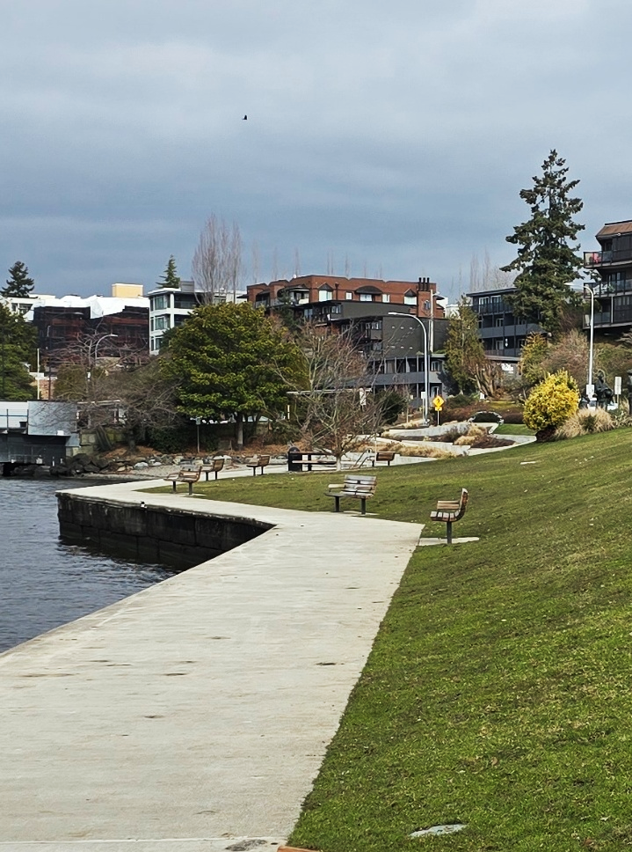
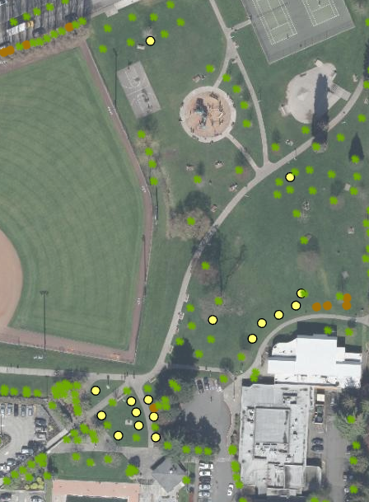
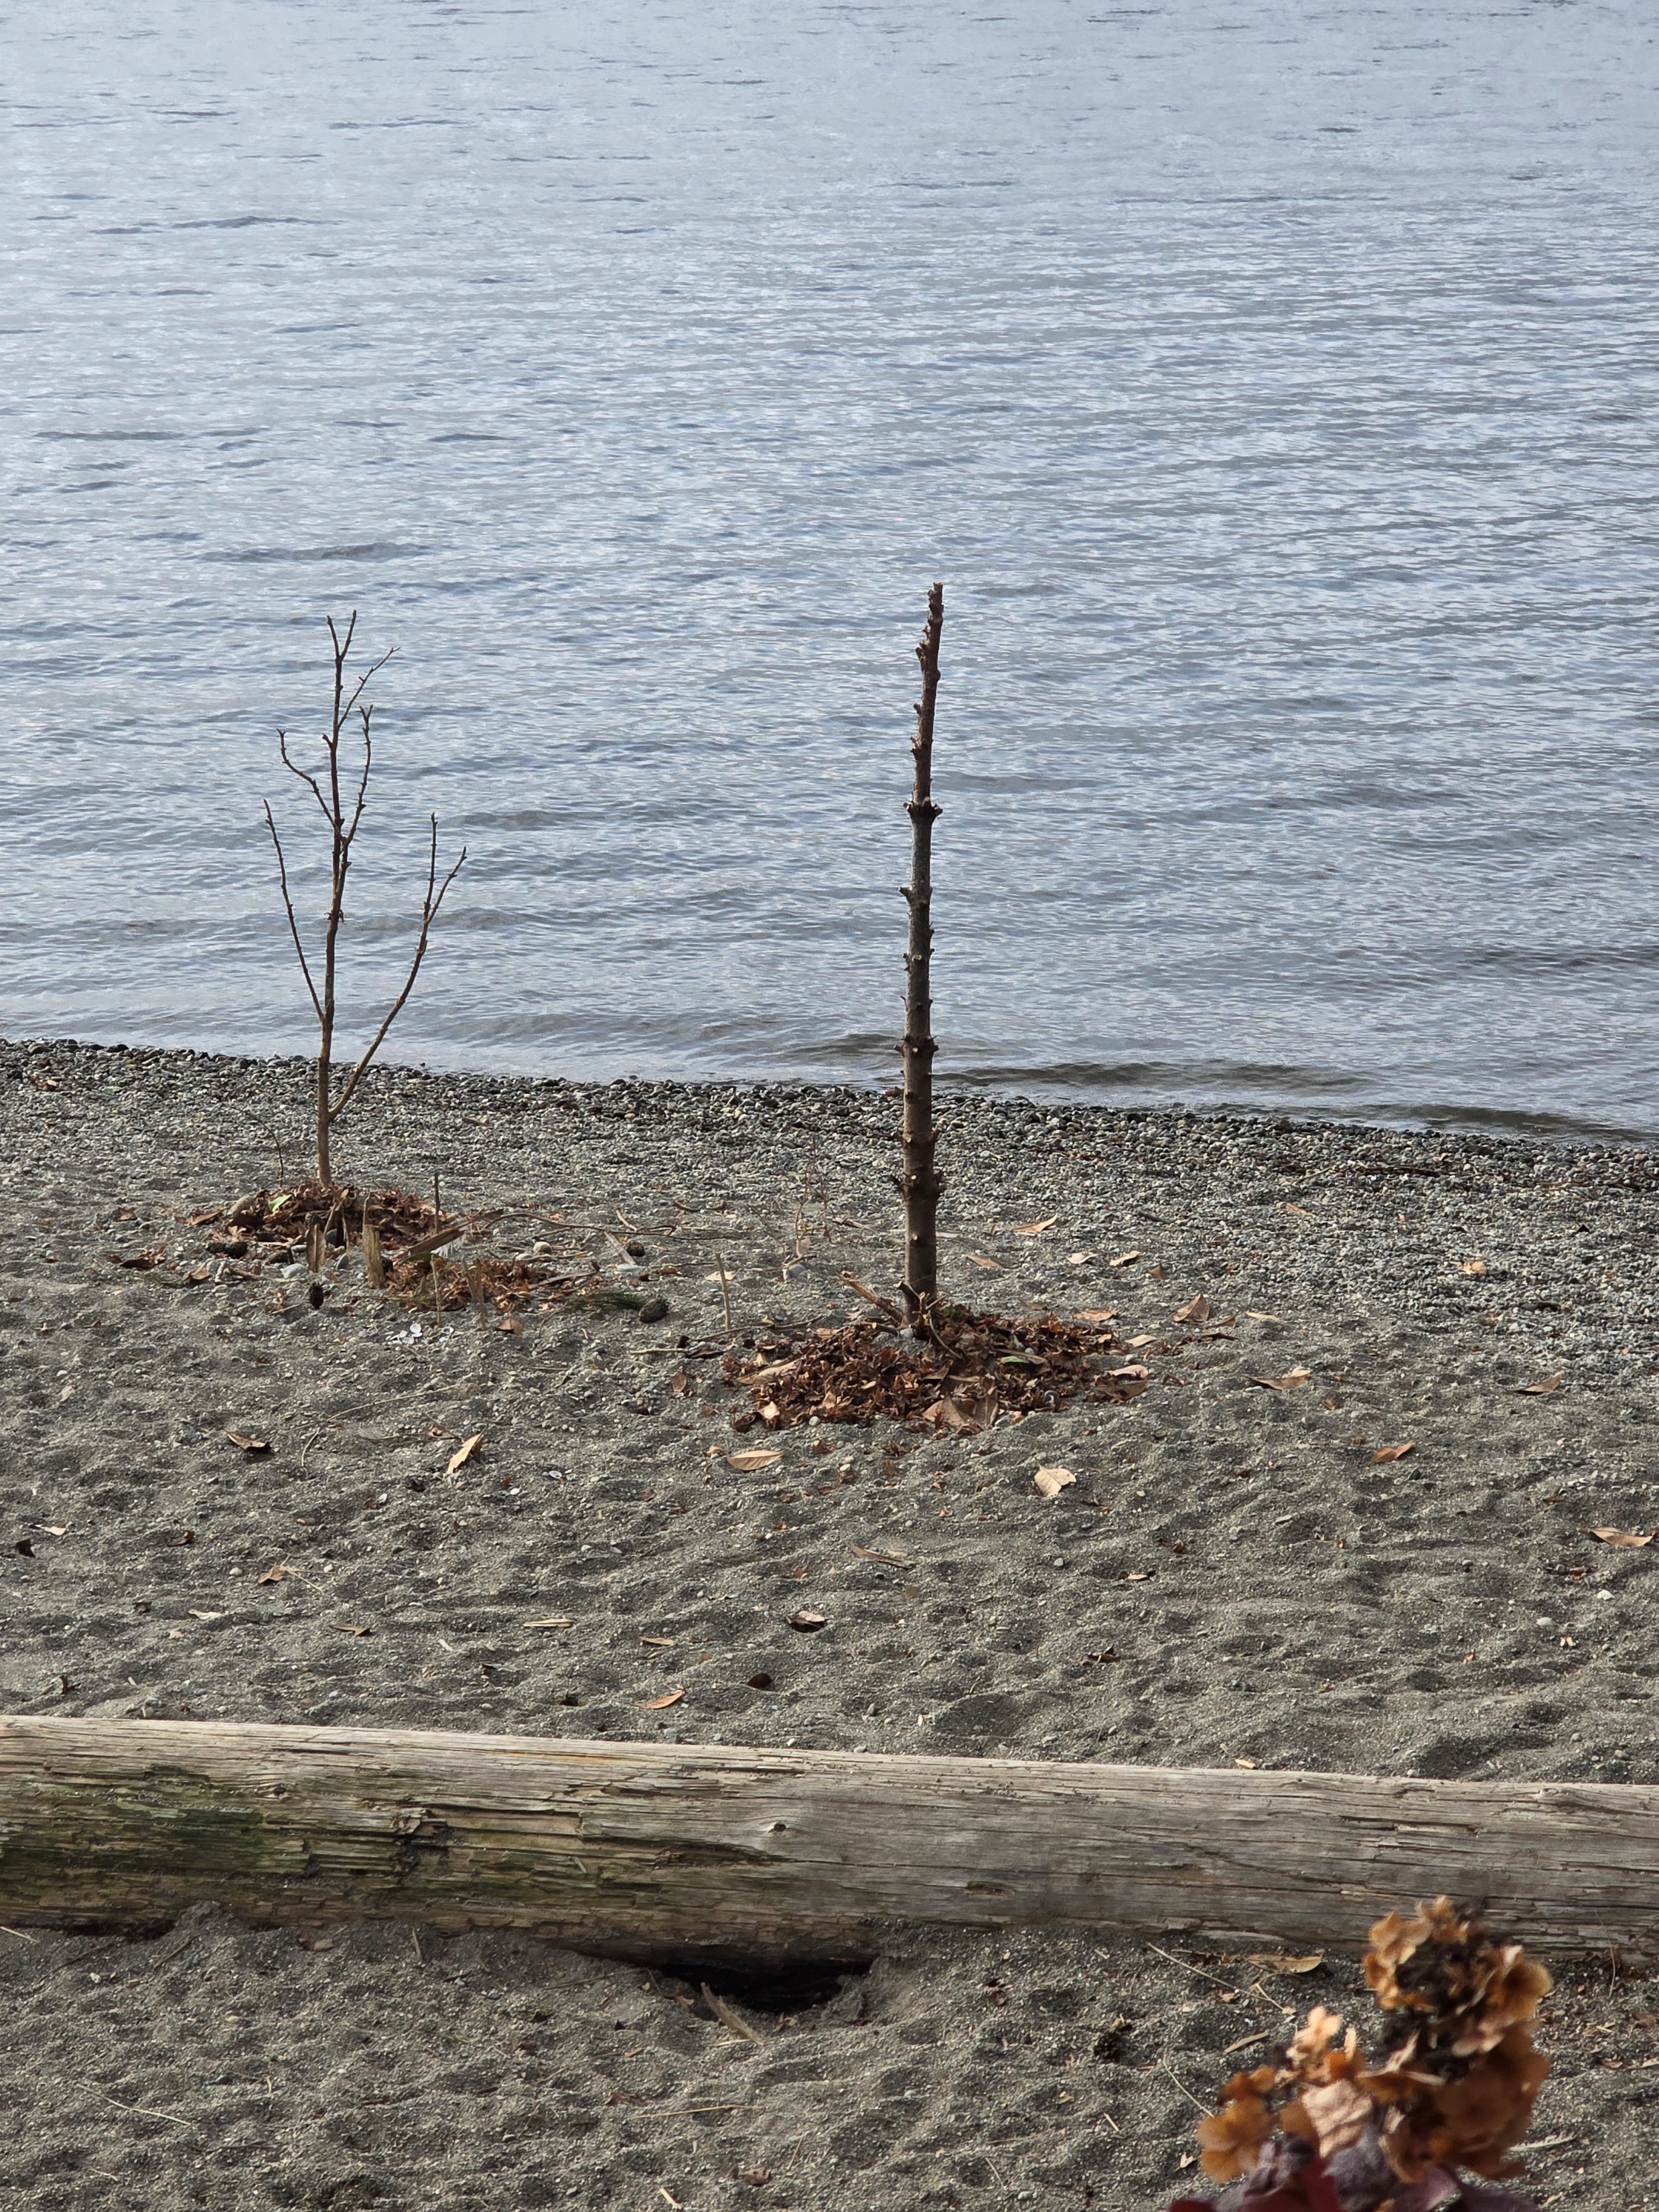
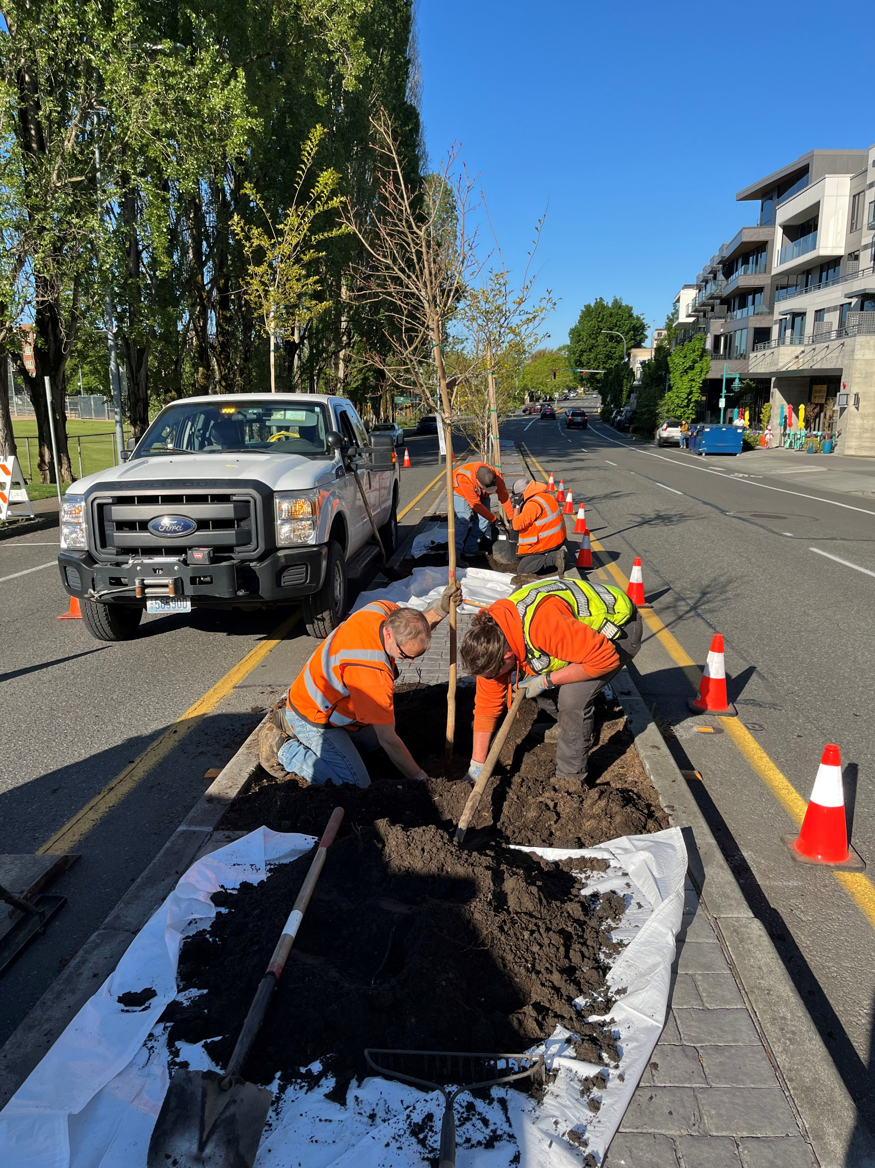
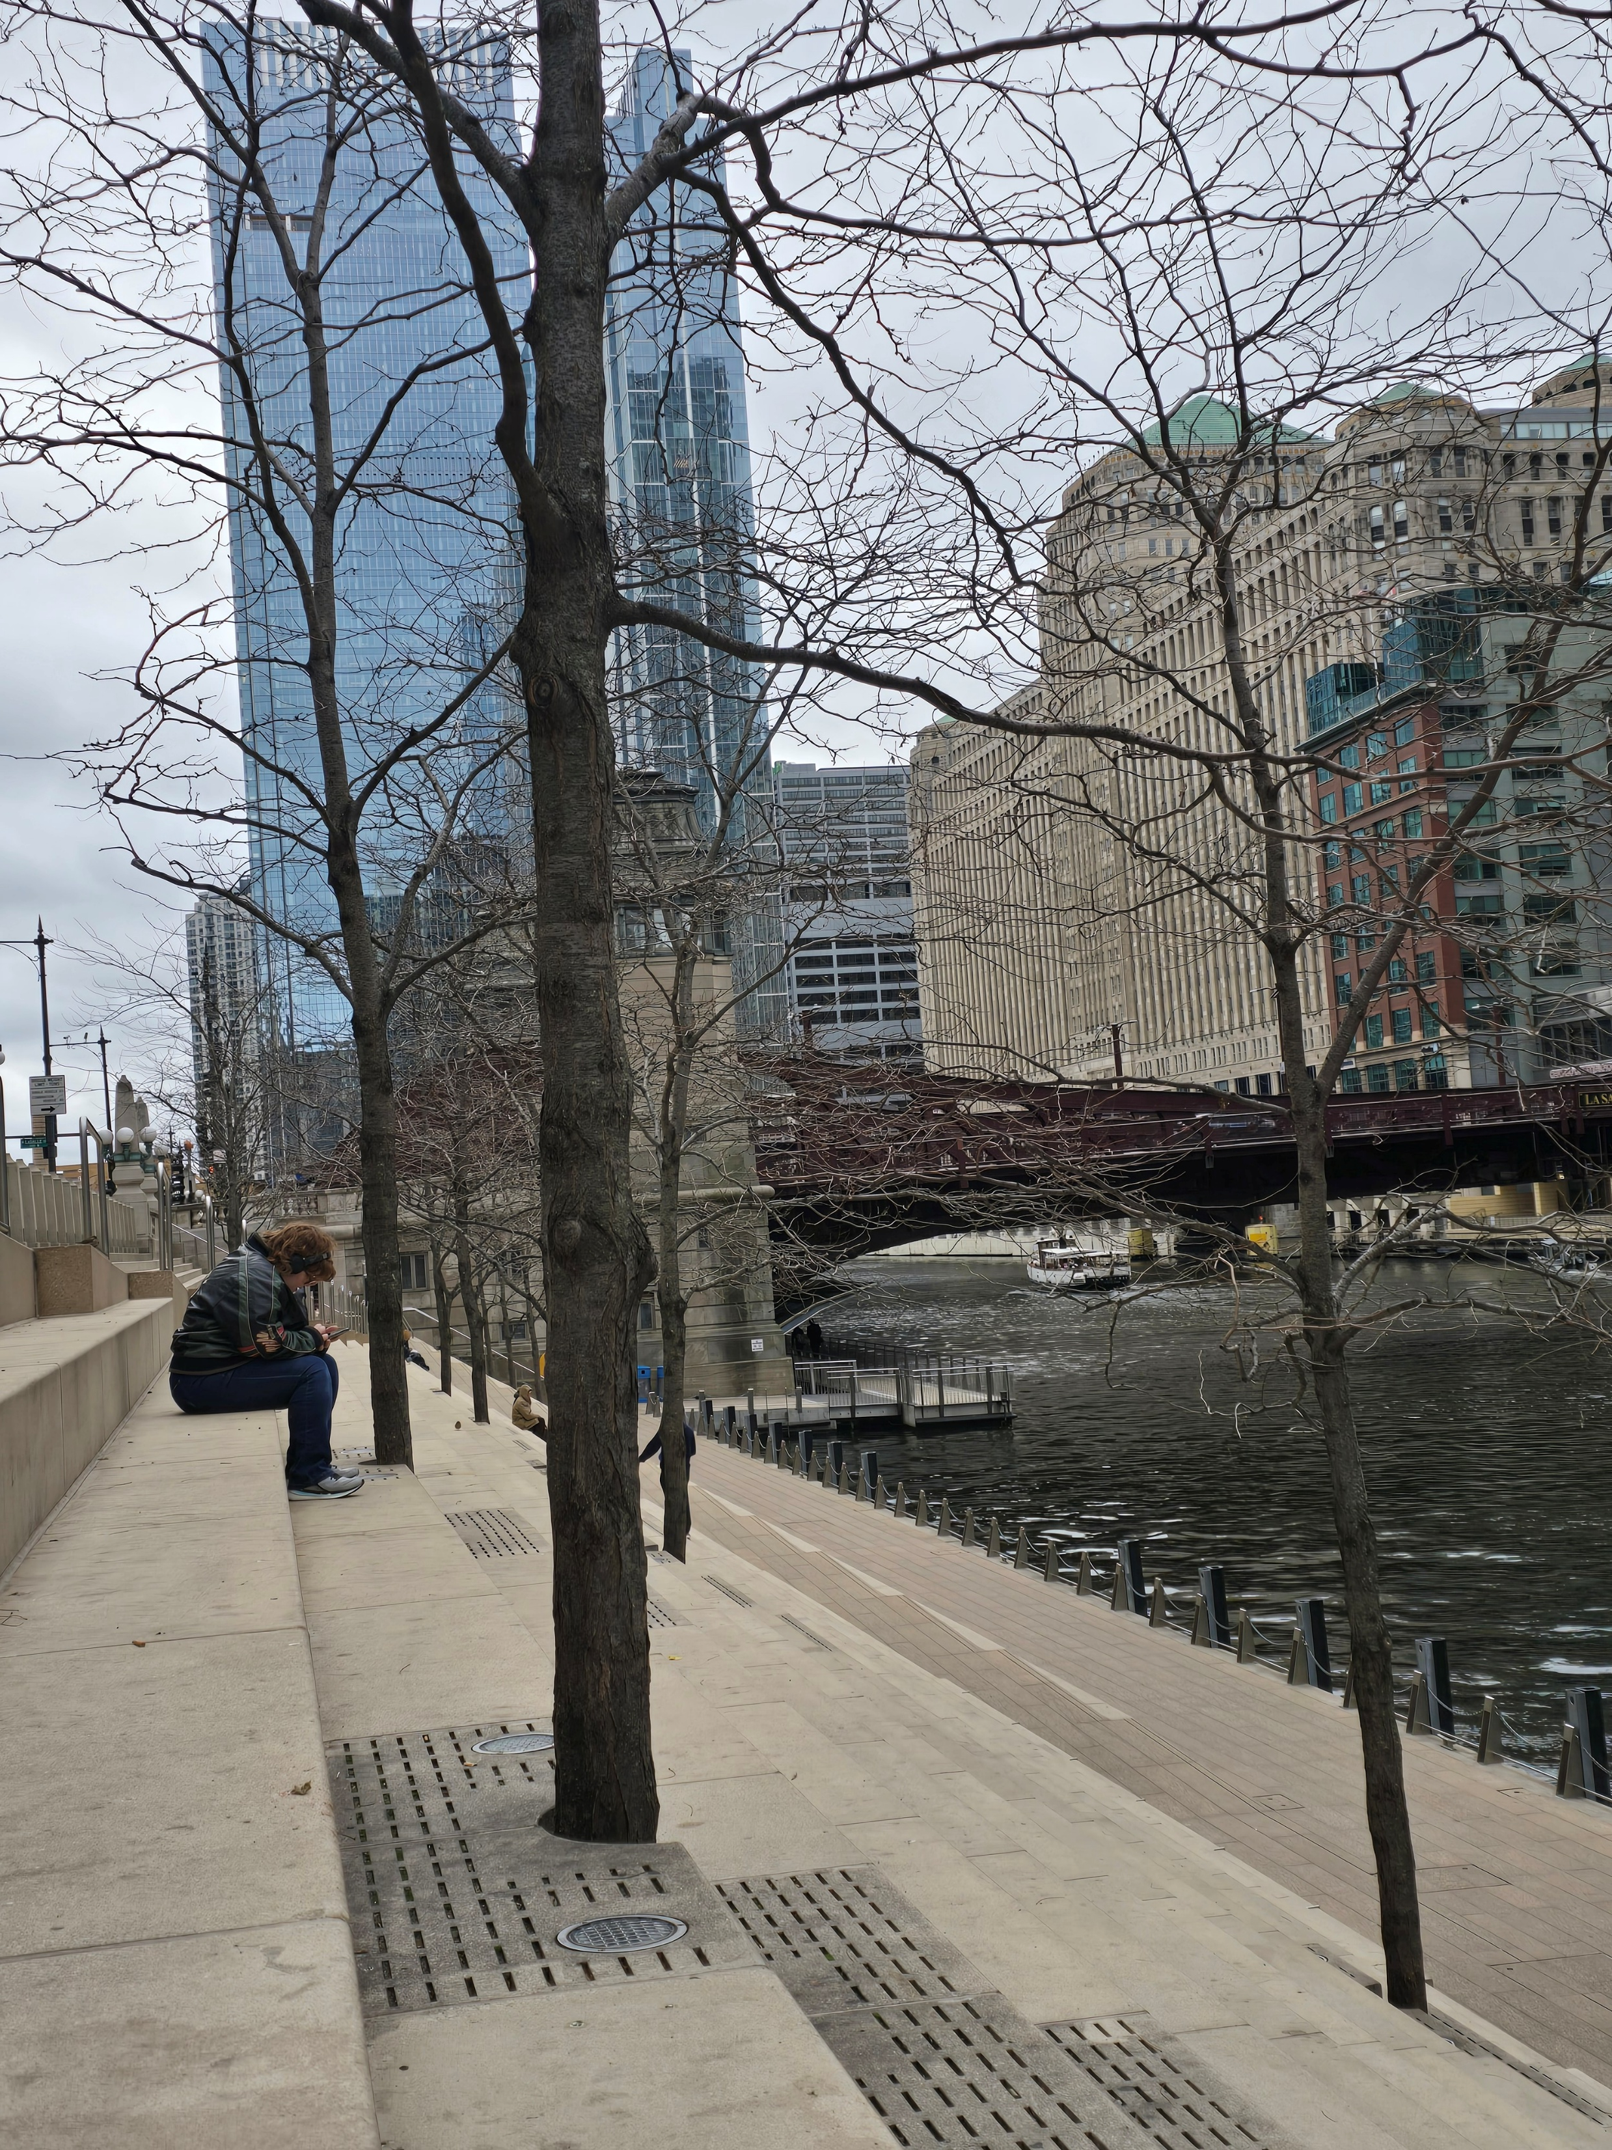
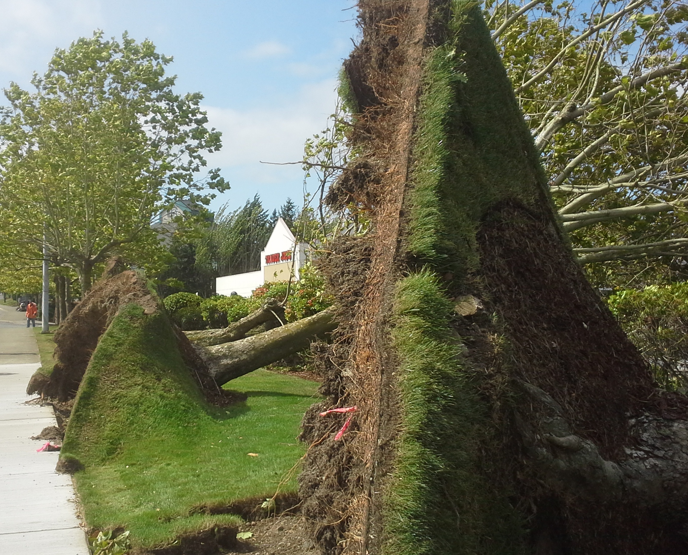
What is going well?
We have data! (tree canopy & tree inventory)
Successful programs
Increased dedicated staff with qualifications
Interdepartmental communication
Regulatory tree code implementation
Recognition and a regional presence
Where can we focus next?
Use data to create management plans:
  Improve existing tree condition
  Improve species suitability for the future
  Increase tree planting and standardize tree establishment programs
Interdepartmental consistency
Invest in the “Community” of Urban and Community Forestry
Notes:
What is going well
GKP MODEL for potential other programs
Data – Change over time, and updatable
Qualifications from implementation through management.
PW and parks have combined for projects using the spider lift, or when 2 arborists were needed for safety and productivity.
My predecessors work on updating the tree code – we are used often as an example. And my experience with communities across the nation – we do great work with Implementation! We have Data we can assess to adapt and improve.
Tree city USA growth awards, evergreen community - part of the development of the UCFS accreditation.
Improvements
reduce staff turnover
increase tree-specific communication and collaboration
develop long-term education and partnership opportunities
build trust, build ownership
One time events, vs something that transcends the individual that invested in it. Like GKP

Slide 8
Heat, Health and
Urban Forest Resilience
Notes:
Before we look forward are there any questions about our past plan, performance, and accomplishments?

Slide 9
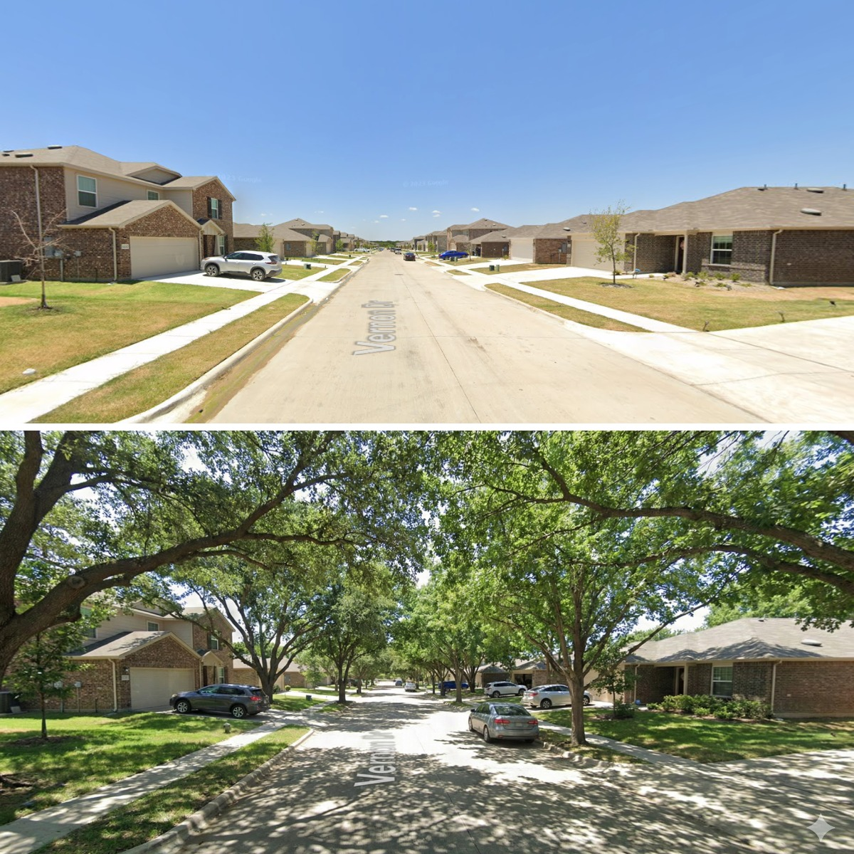
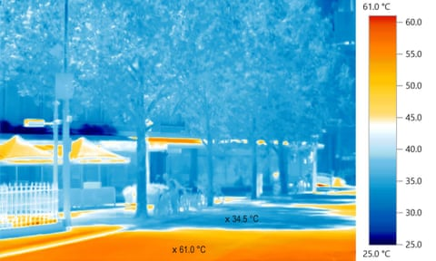
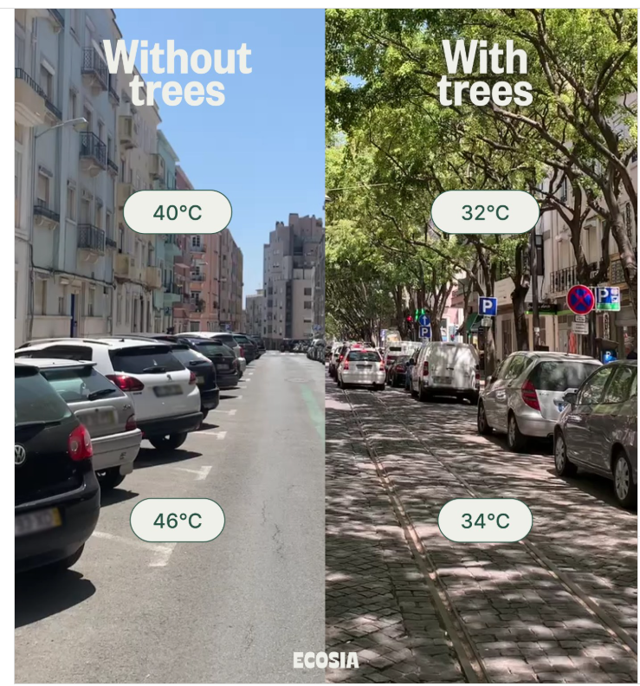
104ºF
90ºF
114ºF
93ºF
~89ºF
~141ºF
Notes:
Urban street trees
https://www.instagram.com/ecosia/p/DLmYNucoRs-/
Reprinted in architectanddesign
Pavement 141.8, 88.7 thermal imaging in Melborn Austraila – pavement temps.
Suburban house photos
https://www.threads.com/@thetransitguy/post/DVMb6HMFQsa/media?hl=en
https://www.lzgardener.com/blog/2015/10/7/good-things-grow-on-trees

Slide 10
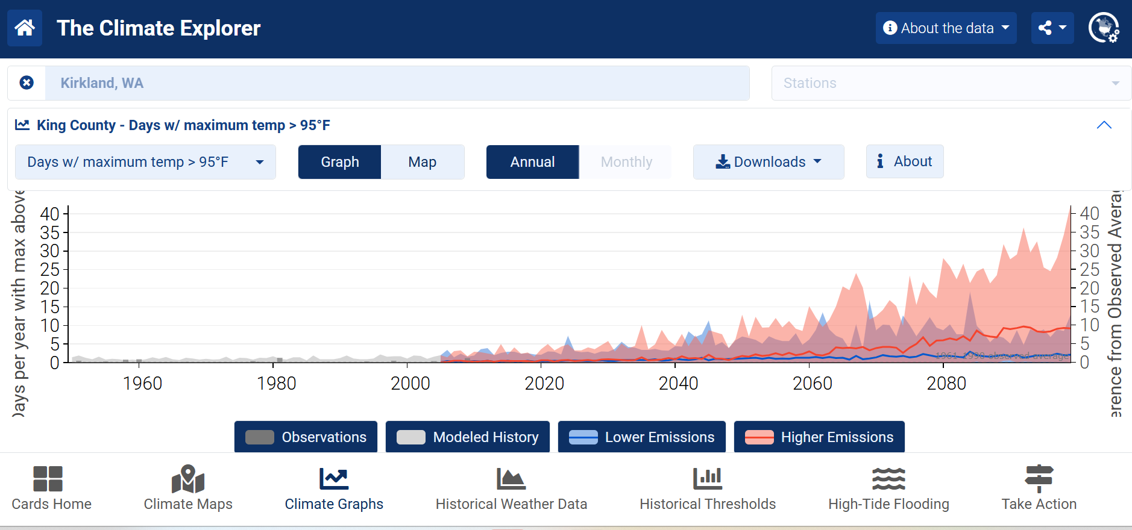
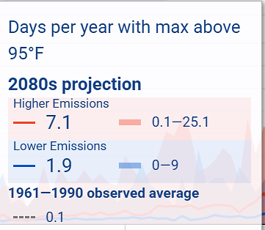
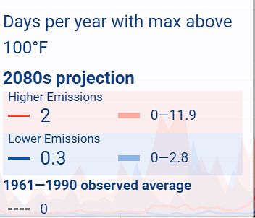
Climate Prediction Applications
Notes:
Climate Explorer
https://crt-climate-explorer.nemac.org/climate_graphs/?county=King%2BCounty&city=Seattle%2C%20WA&fips=53033&lat=47.6062095&lon=-122.3320708&zoom=7&nav=local-climate-charts&id=days_tmax_gt_90f

Slide 11
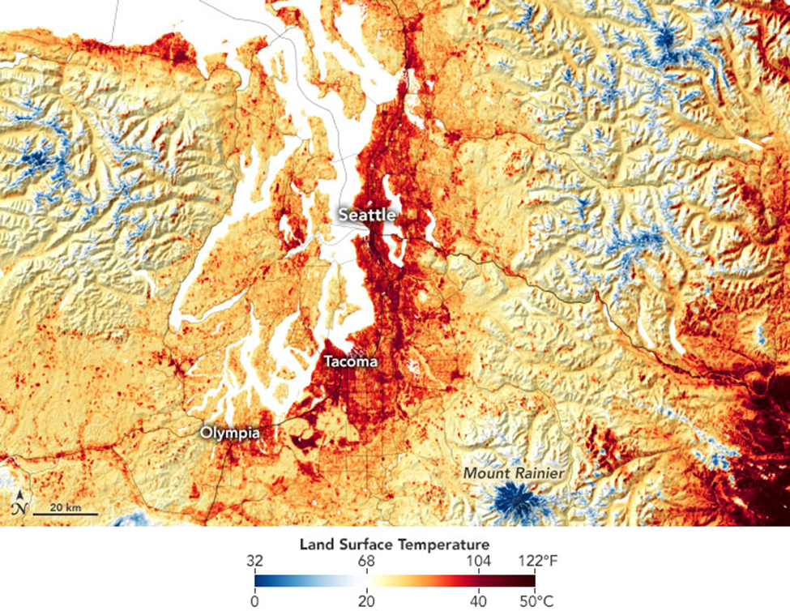
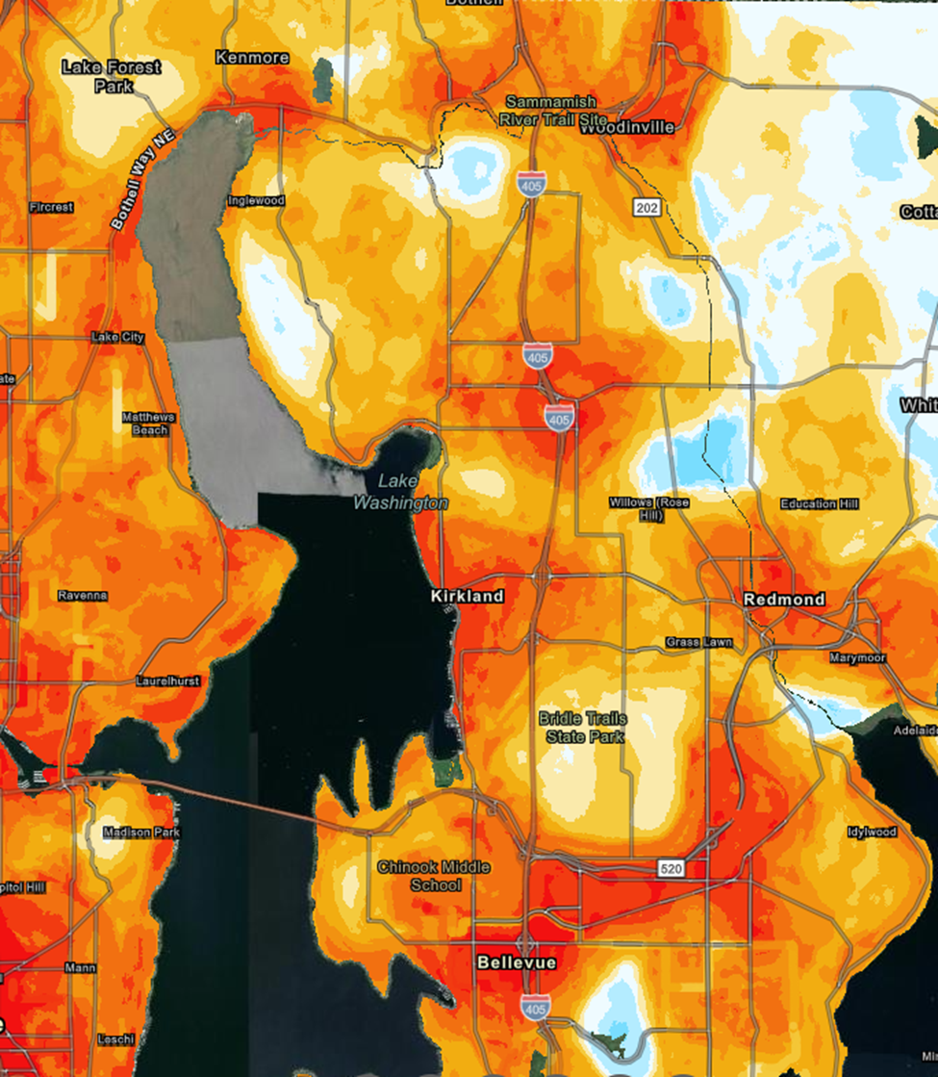
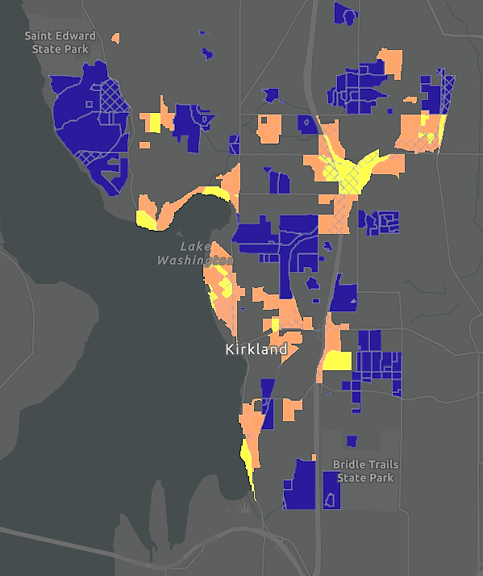
Notes:
Regional heat map for one of the hottest summer days. Make point of temperature changes… and cooling at night.
June 2021 108 in seatac
King County heat and health data explorer tool and King county public health extreme heat responses
https://kingcounty.gov/en/dept/dph/health-safety/safety-injury-prevention/emergency-preparedness/personal-preparedness/hot-weather/extreme-heat
https://kingcounty.gov/en/dept/executive/governance-leadership/climate-office/focus-areas/climate-preparedness/heat-tool?utm_source=copilot.com
King County Heat and Health Data Explorer Tool - King County, Washington

Slide 12
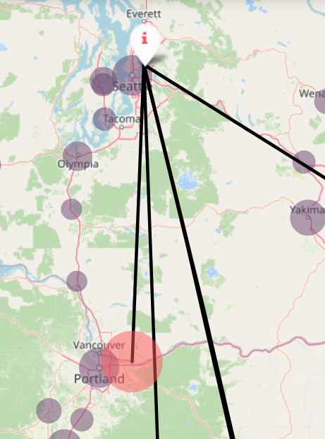
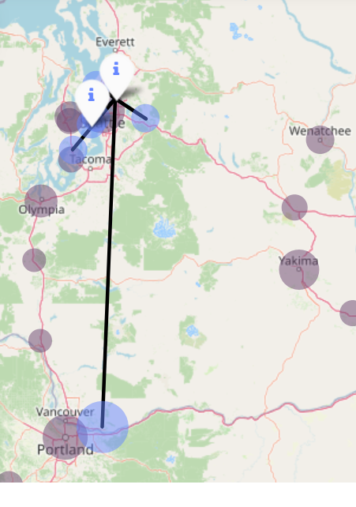
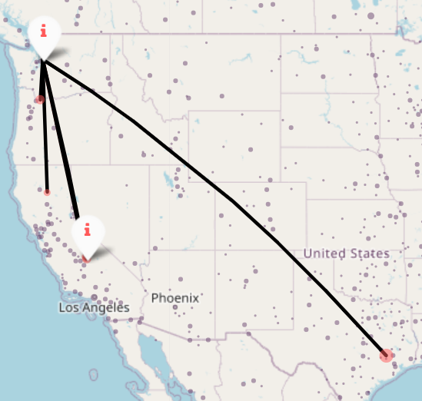
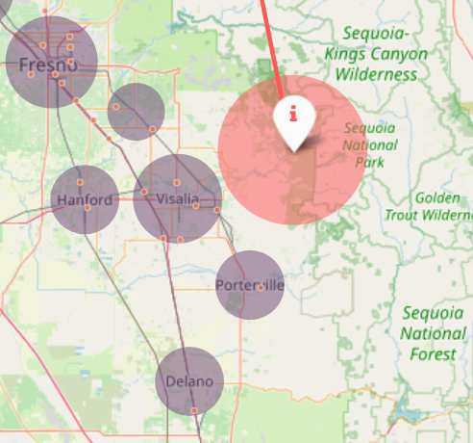
What Will Climate Feel Like in 60 Years?
Low Projection
High Projection
https://www.umces.edu/futureurbanclimates
Notes:
There are tools now to plan for this…. U Mass
What will climate feel like in 60 years
3 deg warmer, winters 14.7% wettr
10 deg warmer and 3.8% wetter
6.7 deg warmer and 15.7 deg wetter in winter
https://www.umces.edu/futureurbanclimates

Slide 13
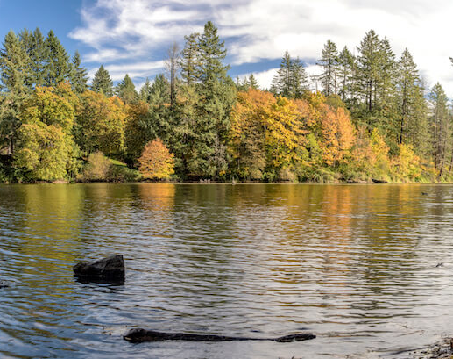
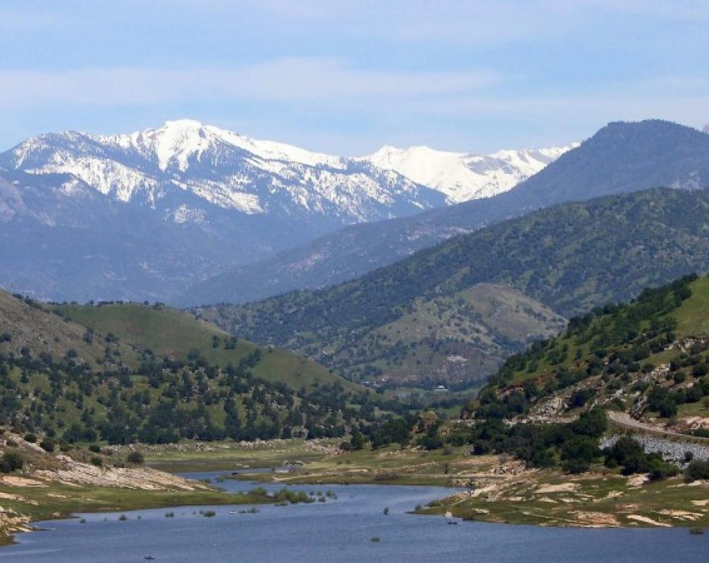
What Will Climate Feel Like in 60 Years?

Slide 14
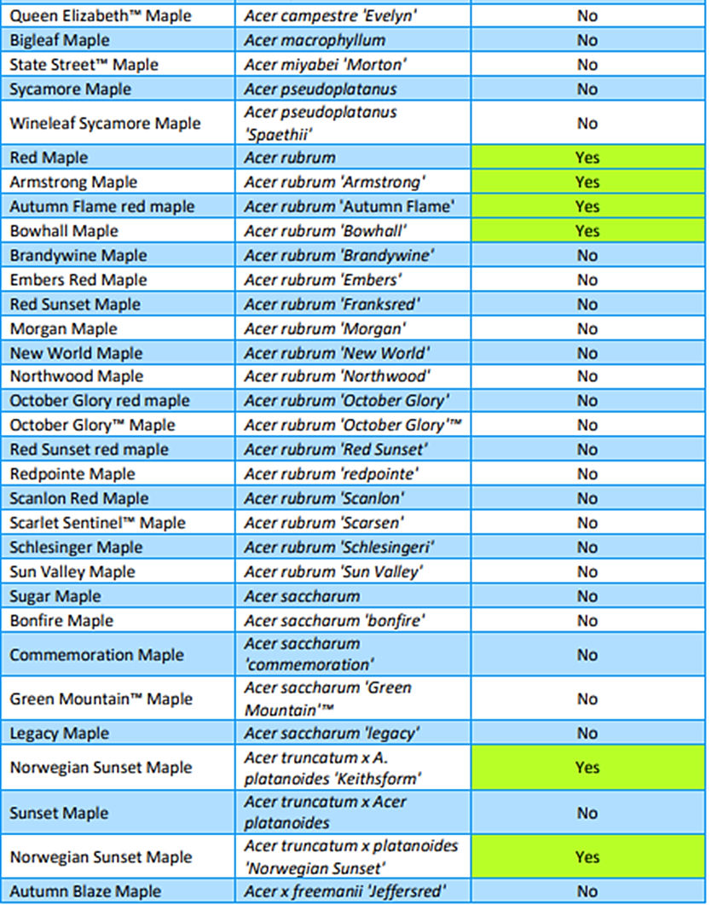
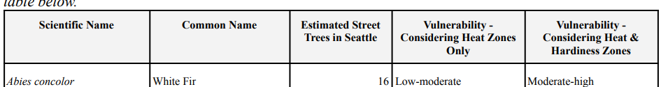
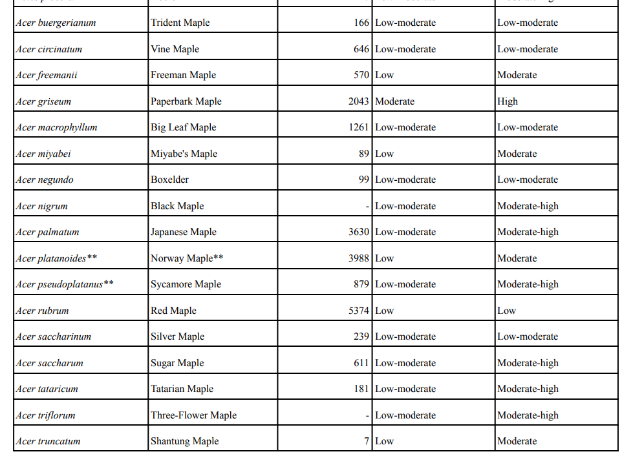
Seattle Region Tree vulnerability assessment and example of a sister city tree list comparison
Notes:
https://www.cityofcamas.us/sites/default/files/fileattachments/parks_and_recreation/page/9532/posmp_appendices.pdf
For Seattle – 33% of the tree species fall in to low vulnerability category and 48% are rated as high or moderate –high vulnerability

Slide 15
Planned Research to Make Informed Decisions
Tree Inventory
  Public tree species vulnerability assessment
  Public tree inventory analysis split by Parks, PW streets, CKC, and Natural areas
Tree Canopy Cover
  Holmes point overlay compared to Finn Hill canopy change
  Neighborhoods with and without public park spaces
  Canopy comparison with tree removal permits
  Stream RMZ baseline and comparison to water quality stations
Other research
  Urban Forestry Community Survey in May
  Tree Removal Permit analysis: removals after property sales, repeat removals, landmark, and dead tree removal ratios etc.
  Urban Community Forest Society and SFI Accreditation standard assessment
Notes:
NOT TREE CODE
Stop for questions

Slide 16
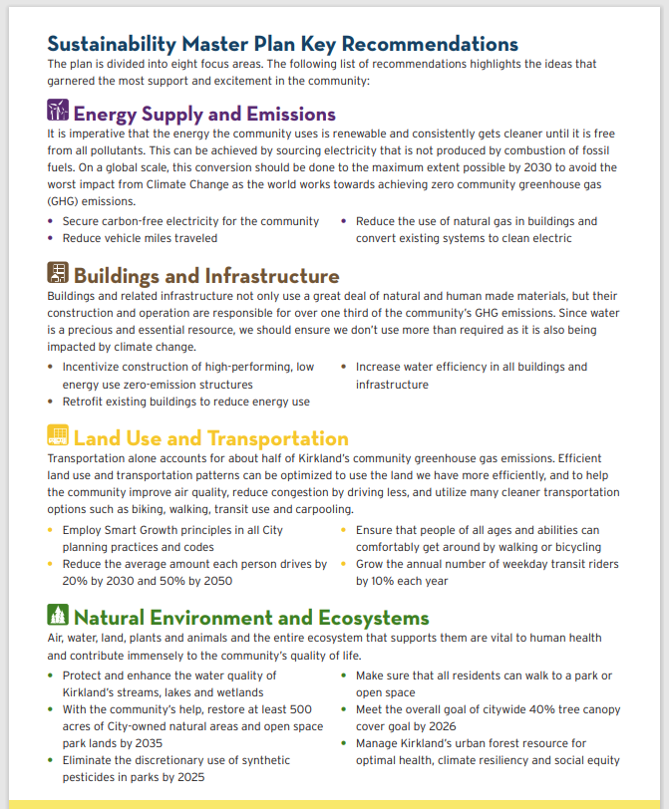
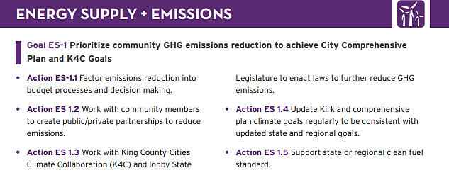
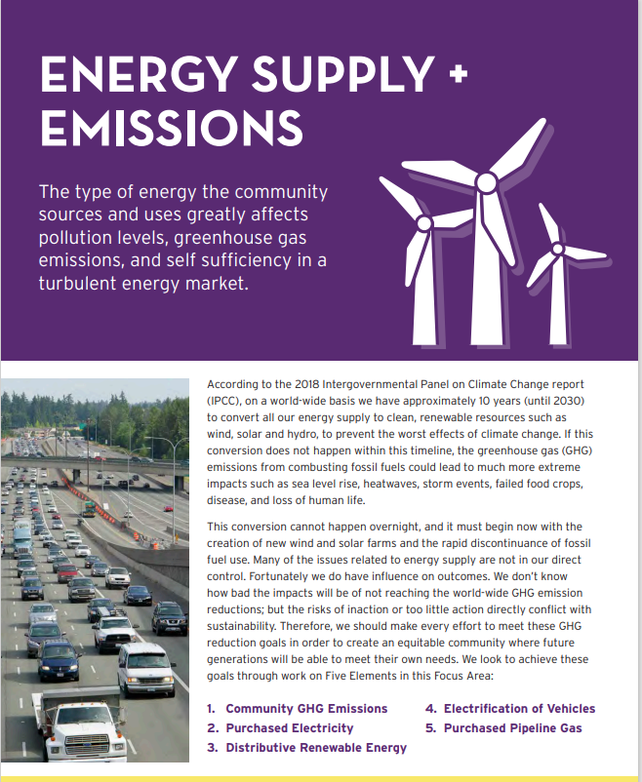
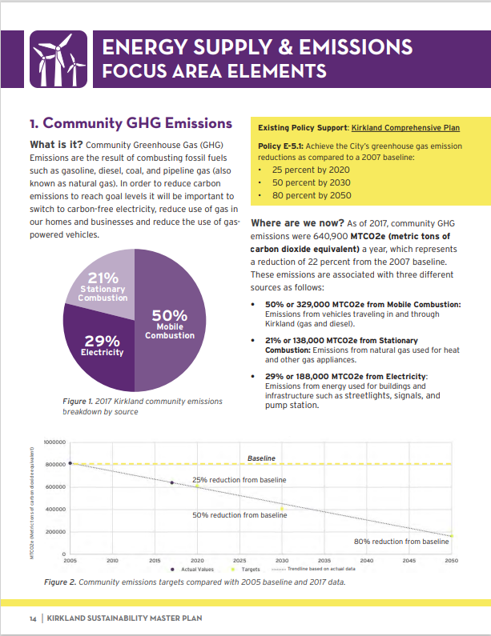
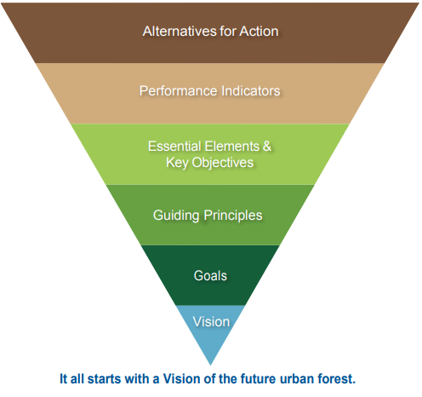
Create a new UFMP using the SSP framework and UFMP Research
Data-based Decision making
Staff Urban Forestry Team
2026 Community Urban Forest Survey
Action | 6 Year Work Plan
ES- 1.1a | Develop and require simple emission work sheet for project budget reports
ES-1.2a | Maintain at least two existing partnerships
ES-1.2b | Develop and trial at least one new project every other year.
ES-1.3a | Ensure on city representative attends quarterly meetings to report back to sustainability team
ES-1.4a | Conduct biennial review of updated state goals and report to council with proposed changes
Council Review and Input
Industry UFMP Guidance, BMP’s and Research
2044 Comprehensive Plan
and Community Outreach
Notes:
1 year
High Level Management Document
No tree Code Focus

Slide 17
What To Expect:
Create a new UFMP using the SSP framework.
Develop a 6YWP using updated standards and goals.
Project Phase/Staff Tasks
final UFMP,
6YWP – select measurable actions to meet objectives that should be prioritized over the next 6 years
draft UFMP,
create measurable objectives to meet goals, define actions to meet objectives
data gathering,
literature review,
project scope and plan
data analysis,
community survey,
draft vision and goals
Jan
March
May
July
Oct
Dec
Jan
Council #1
Project Scope
Council #2 Research Results
Vision and Goals
Council #4
Final UFMP
Draft 6YWP
Council #3
Draft UFMP
Council #5
Adoption
Council/
PC Updates
PC #1
Project Plan
PC #2
Draft UFMP
PC #3
Draft 6YWP

Slide 18
UFMP Discussion Items
Initial thoughts
Community Survey: What would you like to know from the public survey?
Goals and Actions: Do you have any ideas or requests for staff to consider?

Slide 19
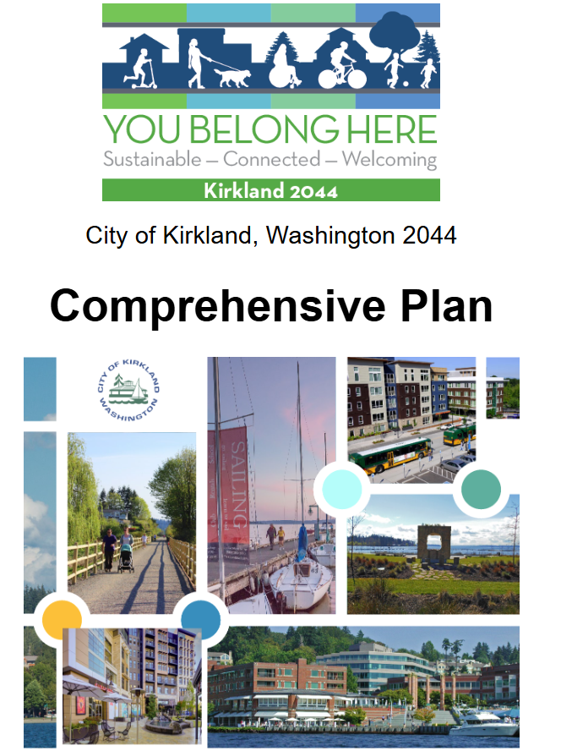

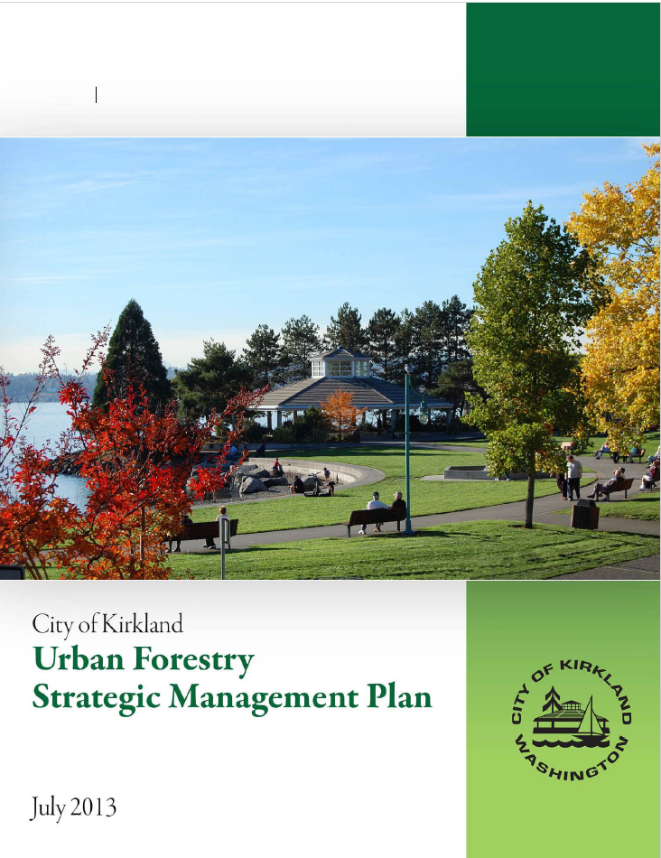
Why new UFMP?
“Kirkland is a Livable, Sustainable and Resilient Community”
“Maintain 40% Canopy Cover”
 | 6 Yr Work Plan Summary
1.0 | INVENTORY TREES
2.0 | MAINTAIN PUBLIC TREES & NATURAL AREAS
3.0 | PLANT TREES
4.0 | COMMUNITY ENGAGEMENT
5.0 | PROGRAM FRAMEWORK
SSP
Notes:
TIME SKILL RESOURCES
Sustainable – Ecological, Economic, Social
ADDED pros AND Surface water plan
6ywp is the Technical implementation plan – Internal….
SCE-2 Plant, protect, enhance, and restore trees and vegetation in the natural and built environment to abate noise, calm traffic, improve air quality, sequester carbon, and ensure resilience to climate impacts.
LU-7 Protect and enhance Kirkland’s natural resources.
PR-3 Protect, preserve, and restore the natural environment for current and future generations
Goals in the 2013 UFMP
DOCUMENT KIRKLANDS URBAN FOREST ASSET
PROTECT, MAINTAIN, AND ENHANCE KIRKLANDS URBAN FOREST
BUILD AN URBAN FOREST PROGRAM
PROMOTE STEWARDSHIP OF THE URBAN FOREST

Slide 20
Continued City Actions while the UFMP is being developed.
From the Tree inventory Recommendations made by Plan-It-Geo
• Utilize inventory data and analysis to develop an Urban Forest Management Plan.
• Monitor trees in less than Fair condition (2,797 trees) Conduct Structural Pruning on trees to promote a healthy structure (2,033 trees)
• Maintain or establish a cyclical, routine tree monitoring and maintenance schedule
• Consider pruning the 3,789 trees with clearance conflicts to bike paths, buildings, vehicles, signs/signals, utilities and sidewalks to enhance safe walking and biking facilities.
• Remove trees that are prescribed for removal and plant trees after removal
• Remove the adventitious sprouts on 373 trees where practical
• Consider removing the stakes from the 1,005 trees.
• Plant trees in the Proposed Planting Sites (Assess planting opportunities)
• Remove the 43 trees marked for high priority removals
• Ensure industry standards and best management practices are followed during the planting and care of trees
• Educate the community about the tree inventory population, the associated benefits, and the tree
management program
• Continue to track maintenance, plantings, and removals in the TreePlotter application
•
Notes:
These recommendations have come from the tree inventory
Change language for red –

Slide 21
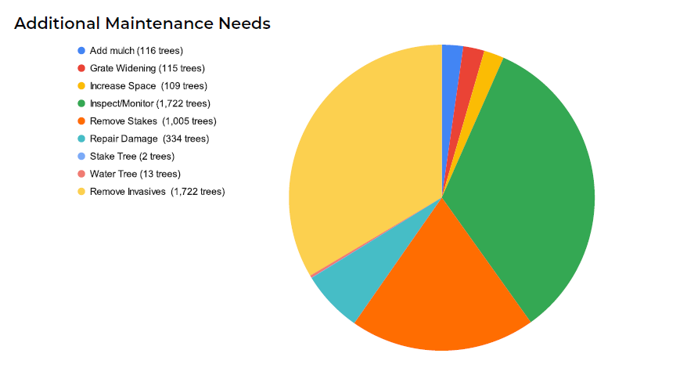
Remove Invasives (1,722)
Inspect and Monitor (1,722)
Remove Stakes (1,005)

Slide 22
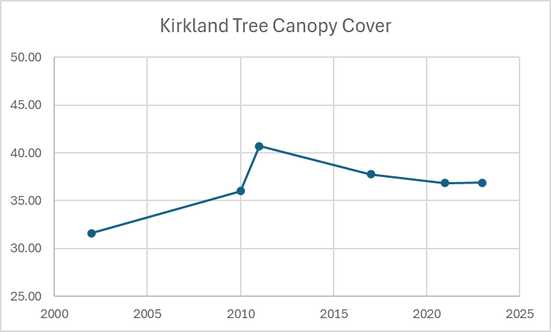
Notes:
2014 data from KC –Plan-It- Geo not collected. DOH

Slide 23
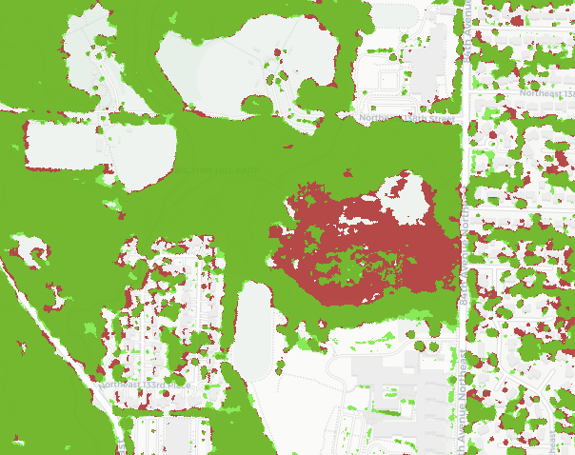
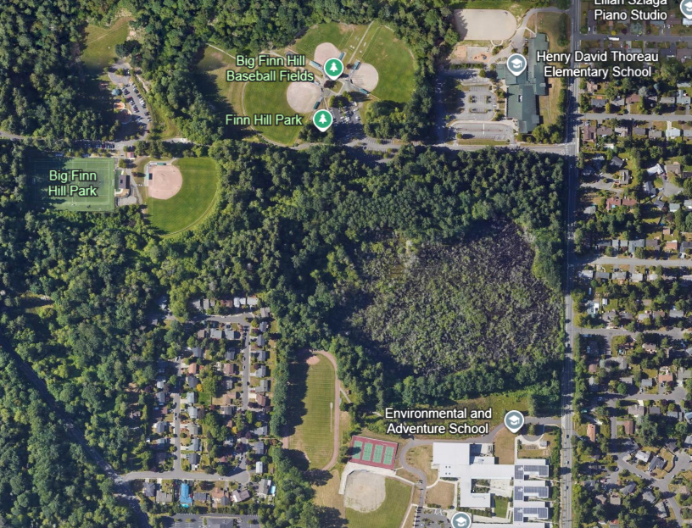
Data Does NOT Tell the Whole Story
The beaver pond in Big Finn Hill park shows a loss of tree canopy (red) This is due to natural causes. Some canopy identification may not have been accurate in 2017 leading to inaccurate conclusions.

Slide 24
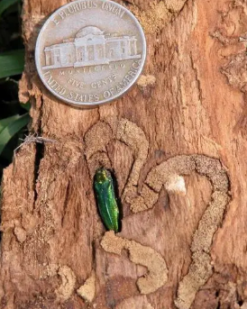
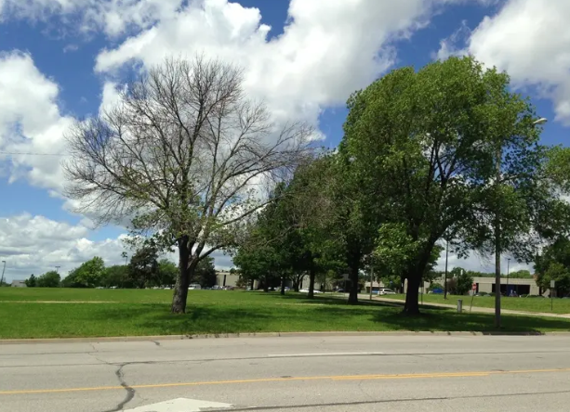
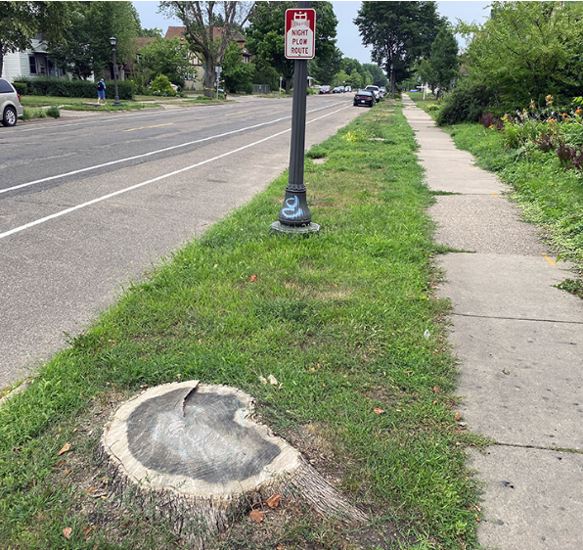
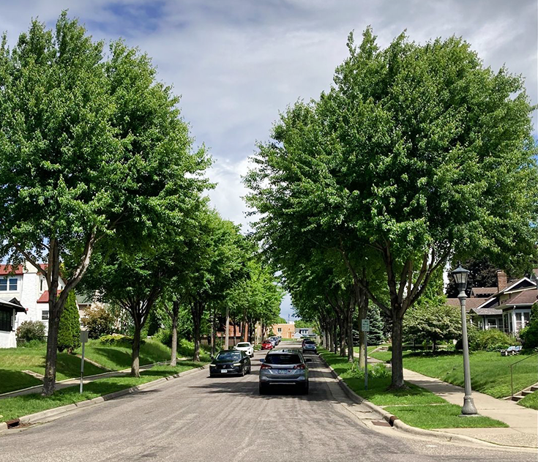
Urban Forest: Readiness and Resiliency
https://www.minnpost.com/cityscape/2024/09/st-paul-marks-bittersweet-accomplishment-in-cutting-down-last-of-the-ash-trees/
Notes:
In 2002… Emarald ash borer discovered. – Nobody was ready – but we have learned a lot since then
In St Paul 2009 - 26,000 ROW ash trees… Over 1/3 oftheir urban tree canopy
BOND - to remove and replace 15 years - just finished last year.
Silver lining
Since 2002 EAB has worked its way across the country
Confirmed in Portland and in Vancouver 1.5 Years ago
Portland has a response plan - .
Portland Parks & Recreation Emerald Ash Borer Response Plan -
1% of urban forest - 10,000 ROW and landscaped park trees, 16,000 private
68K in natural areas. 96K ash trees in Portland
Kirkland is lucky 700 ash…
between 1000 and 2000 for removal and replacement costs could be over 1 million dollars
Imagine if this happened to Douglas fir. Now with our data we can show we have good distribution of trees species, with an emphasis on natives.
We do still have 6700 DF in the inventory (13%)
Spokane – 200 large ponderosa pine trees THIS WINTER –
When we have stresses that impact our Urban Forest we want to be prepared….
One of the Ways we can be better prepared is through focusing goals in our UFMP and work plan

Slide 25
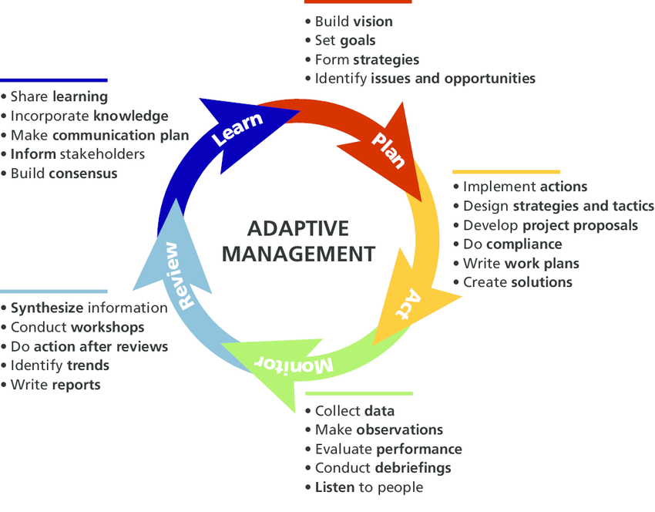
Adaptative Management Cycle
Adjust
6YWP
Notes:
https://www.researchgate.net/publication/305000062_Honoring_the_past_and_celebrating_the_present_100_years_of_research_at_Rocky_Mountain_National_Park
1986 RMNP Ashton et Al 2016
TALK ABOUT EFFICIENCY

Slide 26
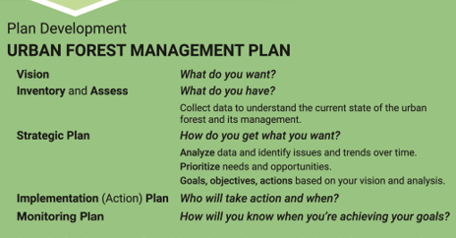
Notes:
two | Urban Forest Management Plan Toolkit

Slide 27
Option 3 UFMP: Develop a new UFMP.
6YWP: Develop using updated standards and goals.
Benefits
Challenges
  Maximum community engagement to develop vision statement and strategic planning goals.
  Additional data assessment and analysis with public reports for tree counts and canopy distribution.
  UFMP will reflect industry standards and BAS.
  Highest cost in both time and resources.
  Scope would extend into 2027.
  Consulting assistance beneficial for both public outreach and final product development.
  6YWP development and project implementation delayed while UFMP development is prioritized.
March 2026
December 2026
March 2027
June 2027
September
2027
Draft UFMP
Draft 6YWP
Final UFMP & 6YWP
Notes:
All choices are valid and will provide forward momentum for the next 6 years
Leverage community to improve ownership
Canopy cover in XX neighborhoods. Neighborhood cover minus public spaces… tree count, canopy in Critical areas…

Slide 28
Option 1 UFMP: Maintain the existing UFMP until 2032.
6YWP: Developed to meet existing UFMP goals.
Benefits
Challenges
  Lowest resource use.
  Fits into current scope in 2025-2027 PWP.
  More staff effort available to focus on implementation and program development.
  No additional public engagement.
  Performance metrics will not incorporate new standards and practices.
  UFMP does not represent 2044 Comprehensive Plan.
  Existing UFMP clarity not improved.
  Inventory and canopy data analysis will be conducted only as needed for the 6YWP.
March 2026
June 2026
September
2026
September
2027
Draft 6YWP
Final 6YWP
Implementation
Notes:
All choices are valid and will provide forward momentum for the next 6 years
All options lead to the same overarching deliverable
Each option has different costs and benefits
Time – Skill/Knowledge – Resources
WHERE TO TALK ABOUT FUNDING? Regional and National?

Slide 29
Notes:
UFMP Tookit –
What has changed since the last bit

Slide 30
UFMP Resources BAS and BMP
WA State – Evergreen community act – mention DNR help…
Comp plan
ISA
TCUSA/Arbor Day Foundation
UCFS –
American forest
3 UFMP examples included from -

Slide 31
The 3+30+300 principle
3 – Visible green
Everyone should be able to see at least three large trees from where they live, work, learn, or receive care. This promotes psychological well-being and connection to nature, and also enhances mental recovery, concentration, learning, and creativity.
30 – Living Area or Climate Green
Neighbourhoods – defined based on local definitions and needs – should have at least 30% tree canopy cover. This provides environmental benefits, such as cooling and improved air quality, while also enhancing our wellbeing and physical health, and fostering more social interactions.
300 – Recreational green
We should all have a high-quality, publicly accessible green space of at least 0.5–1.0 hectares no more than 300 metres walk or bike ride away, ensuring accessibility for recreation and fostering healthier lifestyles.
Yggdrasil – Trädkontoret; NBSI; Cecil Konendike

