Slide 1
2044 Comprehensive Plan Update
CITY COUNCIL | December 13, 2022

Slide 2
KEY THEMES FOR KIRKLAND 2044 UPDATE
Advance diversity, equity, inclusivity and belonging (DEIB)
Sustainability
Housing options for all and housing affordability
Mobility connections to regional transit system and accessibility
Resiliency (future emergencies, pandemic response, economic and fiscal planning)
Smart City Initiatives (transportation, mobility, infrastructure, digital transformation, built environment, community/civic engagement)
Consistency with City Council goals

Slide 3
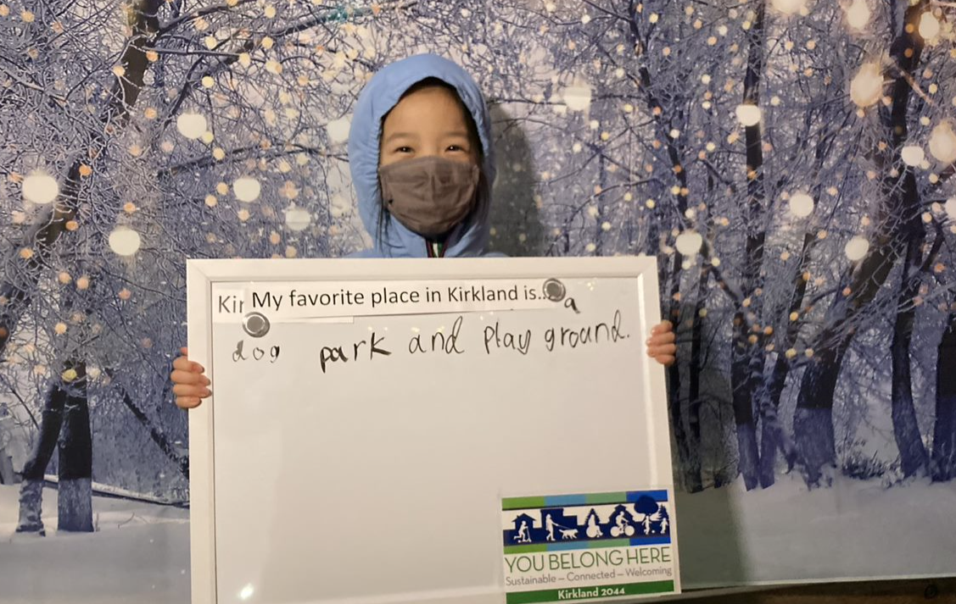
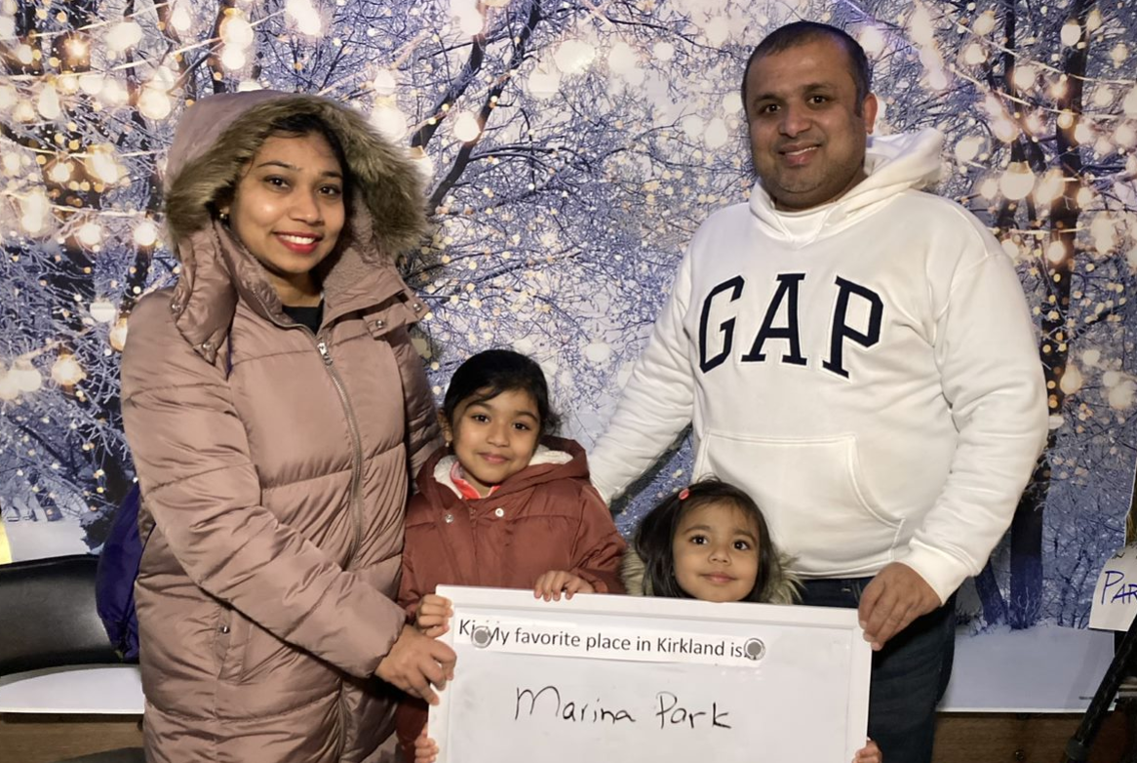
KIRKLAND 2044 COMMUNITY ENGAGEMENT PLAN

Slide 4
KIRKLAND 2044 COMMUNITY ENGAGEMENT PLAN
GOALS OF ENGAGEMENT
Increase involvement from priority populations
Reach stakeholders who want to live in Kirkland but can’t
Involvement is meaningful and resonant with participant's values
People feel heard and understand how their input will be used
Community understands the role of local government in their lives
People want to participate in future planning activities
Build relationships, trust, respect between the City & priority populations
Create a future Kirkland that is stronger, more vibrant, and more inclusive

Slide 5
KIRKLAND 2044 COMMUNITY ENGAGEMENT PLAN
PRIORITY POPULATIONS
Black, Indigenous, and People of Color (BIPOC)
People who identify as lesbian, gay, bisexual, transgender, queer, intersex, asexual plus (LGBTQIA+)
Seniors
Low-income households
People experiencing homelessness
Youth
Renters
People with disabilities or accessibility challenges
Immigrant communities and people facing language barriers

Slide 6
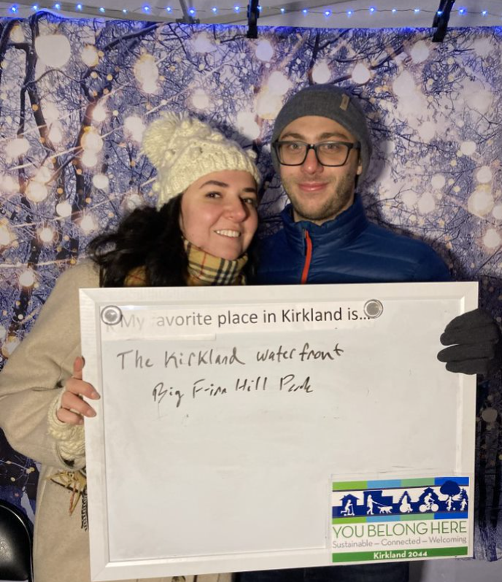
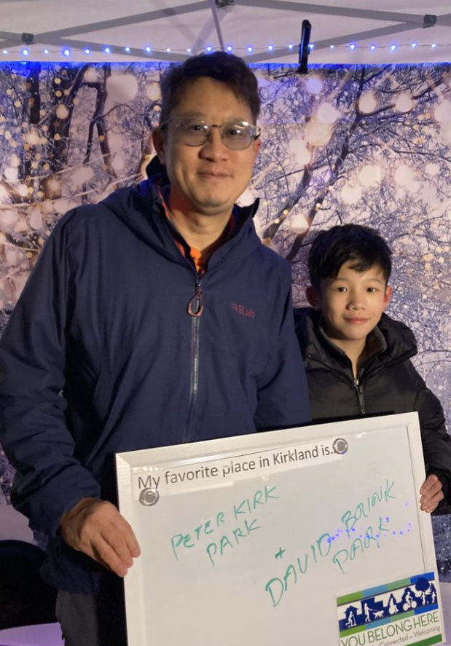
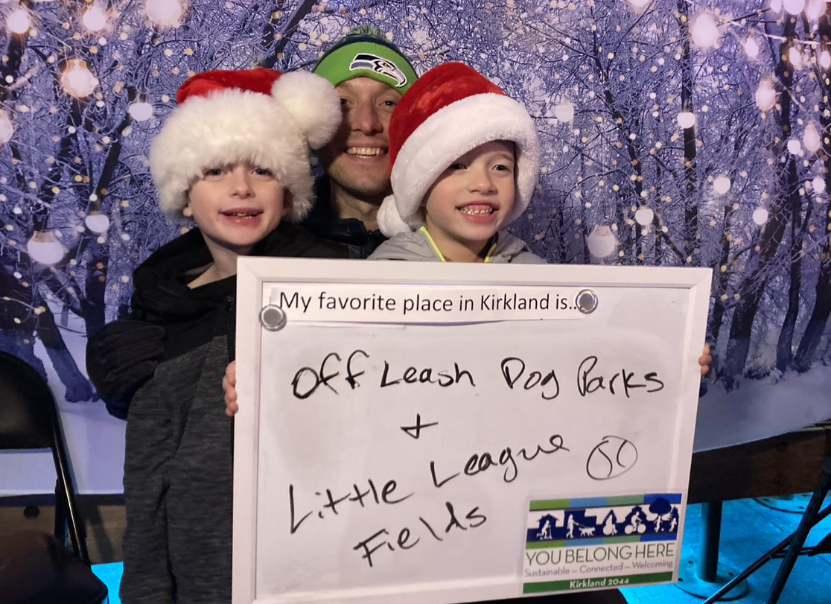
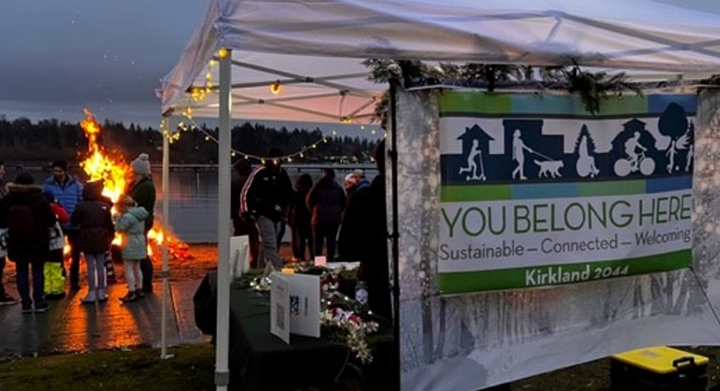
ENGAGMENT STRATEGIES + ACTIVITIES
Community conversations with priority populations, community organizations, neighborhoods
Attend events and pop-up tabling opportunities to “meet people where they are”
Establish focus groups for each Element topic area, lift up underrepresented voices, compensate them for their time and expertise
Engage high school students through curricula

Slide 7
ENGAGMENT STRATEGIES + ACTIVITIES
Key messaging: avoid planner speak; find out what’s important for people’s everyday lives
Media, social media, email announcements to be coordinated with communications staff
Surveys and quick snap polls
Outreach materials like handouts and StoryMaps
Videos at various phases
“Close the loop” after each phase to reflect back what was heard

Slide 8
Sustainability, Climate, Environment
(Surface Water Master Plan, PROS Plan)
Housing + Human Services
Economic Development
January 11
Kick-off Visioning Event
City Services
(Public Services & Facilities, Utilities, Capital Facilities)
Transportation + Land Use
March & April
July & August
Dec & Jan
Feb & March
May & June
Sept & Oct
Outreach
2023 Schedule for Community Conversations and Focus Groups for each Element
Notes:
Show that each wave grouping Elements together; will have different staff teams

Slide 9
KIRKLAND 2044 EQUITY REVIEW REPORT

Slide 10
KIRKLAND 2044 EQUITY REVIEW REPORT
Equity gap analysis of existing Comprehensive Plan text and policies
"How to” guide to plan for equity
Companion document to Kirkland’s DEIB 5 Year Roadmap
Community Profile for Kirkland
Report Recommendations:
Provides “questions to consider” to embed equity in policies
Policies to mitigate displacement of vulnerable populations
Support inclusive engagement
Improve access to opportunities for the whole community
Scan of State, Regional, King County, equity and inclusion policies
Specific text and policy improvements to integrate into the revised Plan

Slide 11
Examples of text and policy changes
1. Incorporate a more accurate recounting of Kirkland’s Indigenous peoples and history:
Integrate findings from Kirkland’s Native History Document
Be more explicit in acknowledging colonization and its ongoing impact upon Indigenous groups
2. Acknowledgement and remedies of discrimination in housing:
Shift priorities from the preservation of historically exclusionary concepts such as “neighborhood quality” and “community character” and emphasize the importance of ensuring affordable, accessible, healthy, and safe housing for all.
Improve the City’s efforts to preserve existing affordable housing stock and mitigate displacement of vulnerable residents and services.

Slide 12
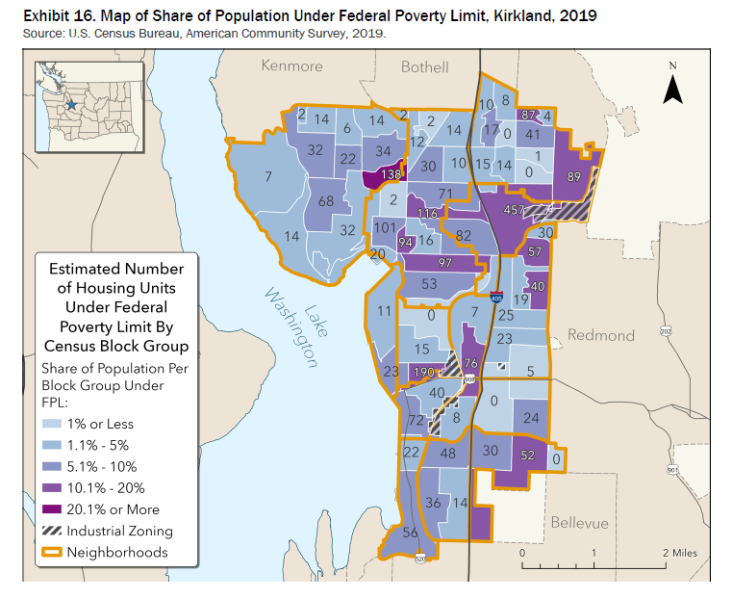

Slide 13
Timeline and Project Phasing 2022-2024
Community Engagement and Communication Throughout Process
We are here
Organizational Approach
2020-2024 Work Program Adopted
Assess state/regional requirements
Develop Community Engagement Plan
Community Visioning Process
Identify Issues
Data Collection
Draft vision statement
Revise Plan Elements
TMP Update
Scope Environmental review
Prepare Draft Plan
TMP & Environmental Review
Public Hearings
Early 2022
Summer 2022
Fall 2023-
Summer 2024
Fall 2022
Winter 2022-
Summer 2023
City Council Adopts Final Plan
Fall 2024

Slide 14
How can people get involved?
Learn more by visiting www.kirklandwa.gov/k2044 and sign up for email alerts
Send us your thoughts by emailing 2044ComprehensivePlan@Kirklandwa.gov
Share Your Feedback by Taking This Short Survey Click this link K2044 Community Visioning Survey
Attend Virtual Visioning Event - January 11th, 2023 from 6:00 pm to 7:30 pm PST
Upcoming tabling events:
Urban Frostival & Winter Market- December 17, Kirkland Urban

Slide 15
DISCUSSION
Questions or comments on either report?
Direction to staff moving forward?

Slide 16
Housing Element Requirements (HB 1220)
Plan and accommodate housing affordable for all income levels
Analyze demographic, racial, housing data and evidence of potential displacement in Kirkland
Identify areas at higher risk of displacement from market forces that occur with changes to zoning development regulations and capital investments
Implement data-informed and community vetted policy solutions
Identify policies, regulations that could result in racially disparate impacts, displacement, and exclusion in housing
Identify and implement policies and regulations to address and undo those impacts above
Establish anti-displacement policies
Resource presentation: Updating GMA Housing Elements- WA Department of Commerce

