Slide 1
2044 Comprehensive Plan Update
CITY COUNCIL | April 19, 2022
Adam Weinstein, Director, planning, and building
Jeremy Mcmahan, deputy director, planning and building
Janice Swenson, senior planner

Slide 2
Regulatory Requirements for Update
Comprehensive Plans must be updated by December 2024 (2022-2024)
Plan for horizon year of 2044
Washington State Growth Management Act (GMA) Goals – amendments since the last update
Washington State Department of Commerce (DOC) – review checklists for cities to address state law, policy, and regulatory updates required under new state laws
Puget Sound Regional Council Vision 2050 Regional Growth Strategy – must be consistent with Vision 2050 multi-county planning policies
King County Countywide Planning Policies (CPPs) – must be consistent with King County planning policies, and plan for County-allocated employment and housing growth targets

Slide 3
Kirkland’s Growth Targets
Existing Housing Units 2018* | K2035 Plan existing remaining housing unit capacity (2015-2035) | Target K2044 new housing units (2019-2044) | Existing Jobs 2018* | K2035 Plan existing remaining jobs capacity (2015-2035) | Target K2044 new jobs (2019-2044)
38,656 | 13,352 | 13,200 | 49,280 | 18,139 | 26,490

Slide 4
Local Needs-Key Themes for Update
Advance social justice, equity, inclusivity and belonging
Sustainability
Housing options for all and housing affordability
Mobility connections to regional transit system and accessibility
Resiliency (future emergencies, pandemic response, economic and fiscal planning)
Smart City Initiatives (transportation, mobility, infrastructure, digital transformation, built environment, community/civic engagement)
Consistency with City Council goals

Slide 5
2022-2024 Update Objectives
Use the current plan as the foundation for update; not a complete re-write of plan
Plan for our housing and employment growth targets; City will likely have zoning capacity to meet targets
City can be very intentional where it chooses to create additional capacity to achieve community goals like increasing affordable housing
Conduct a visioning process to re-assess if the Vision Statement and Guiding Principles express the community’s values and embody the desired future
Revise General Elements to comply with State, regional requirements and Countywide Policies, City Council goals; interdepartmental staff team approach; equity scan to remove exclusionary text
Incorporate updated functional plans into the related General Elements (PROS Plan, Surface Water Master Plan, Sustainability Master Plan, Transportation Master Plan, etc.)
EIS will allow us to study options for growth in Land Use, Transportation Master Plan/Transportation Elements with EIS Consultant Services

Slide 6
Community Engagement Plan
Planning staff will partner with the City Manager’s Office to develop an innovative community engagement plan
Build on engagement strategies from K2035 update to create equitable and inclusive outcomes; community participation with those who have not traditionally participated
Use existing City outreach platforms, methods, and networks, explore other techniques: in-language events, honoraria payments, and trusted messenger outreach
Provide a variety of in-person or virtual options: workshops, open houses, town halls, focus group stakeholder meetings, surveys, project webpages, interactive portals for comments, community events, virtual City Hall lobby
Meetings with: Boards and Commissions, neighborhoods, civic organizations, special purpose districts
Consultant Services:
design a robust community engagement strategy that is equitable and inclusive; City staff implements
review Plan policies for consistency with the draft Roadmap; initiatives related to equity including R-5240 (Safe, Inclusive, and Welcoming) and R-5434 (Black Lives Matter)

Slide 7
Neighborhood Plans Discussion
K2044 Update Recommendations:
review all neighborhood plans for consistency with equity & inclusion efforts, city-wide policies
only conduct a major update of Juanita and Kingsgate neighborhood plans in 2023
Long Term Recommendations:
retain neighborhood plans in the Comprehensive Plan; update only with 8 yr. Comprehensive Plan update cycle
in between cycles, neighborhood could request special consideration for an update w/Planning Work Program
in between cycles, property owners could seek community-initiated amendment requests (CARs)
community feedback on this change will be essential (separate work program task)

Slide 8
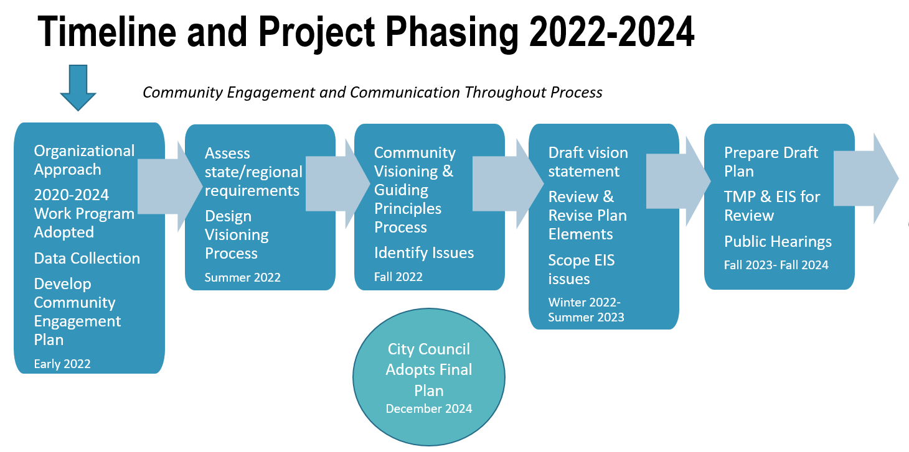
Project Phases

Slide 9
Questions for Council Discussion
Does Council agree with the key themes for the K2044 process?
Are there particular issues or topics that the Council would like to include in the Plan update?
What expectations does the City Council have for the community engagement process?
Does Council have feedback on staff’s recommendations:
Limited updates to neighborhood plans? Complete major updates for Juanita and Kingsgate neighborhood plans in 2023.
Initiate community outreach to update neighborhood plans concurrent with the 8-year Comprehensive Plan cycle?

