Slide 1
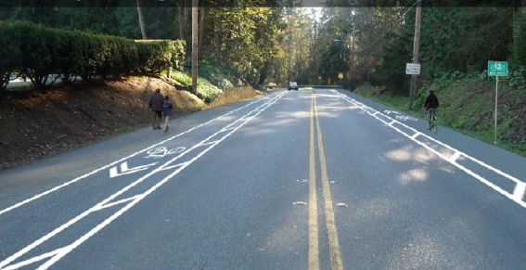
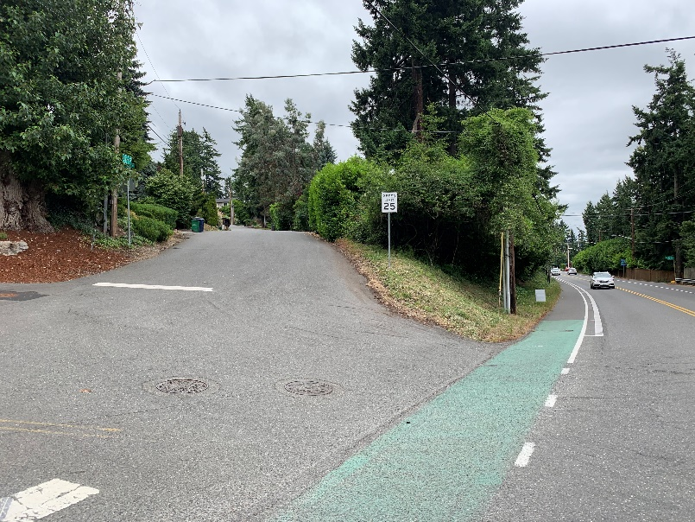
Juanita Drive Multi-modal, Intersection and Safety Improvements Kirkland Transportation Commission – September 23, 2020
Multi-modal
Safety
Laura Drake, P.E.
Project Engineer
Public Works – Capital Improvements Program
City Council Study Session October 6, 2020

Slide 2
Presentation Overview
Project Background
Design Update and Opportunities
Funding and Timeline Update
Next Steps

Slide 3
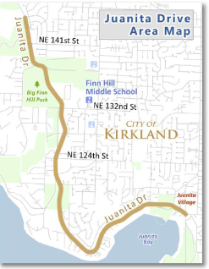
Project Background
Juanita Drive Area Map
The Juanita Corridor Study was adopted in 2014
Addresses service needs in the annexation area
coordination with agency partners such as Kenmore extensive investments their segment of the Juanita Dr. Corridor
The project recommendations focused on:
Safety improvements for all modes
Ped/bike facility needs
Drainage deficiencies
Study identified 33 project sites at a total cost of $19.3M [2014 dollars]
North Limit
FS 25
South Limit
Additional intersection

Slide 4
Project Background
Juanita Drive Area Map
3 CIP projects were created to complete 19 sites:
Quick Wins accepted by Council June 2019
11 project sites
$1.96M, including $1.35M federal safety grant
Intersections & Safety (STC 089) and Multimodal (NMC 09010) [this update]
7 project sites (between NE 112th Street and NE 132nd Streets
North Limit
FS 25
South Limit
Additional intersection

Slide 5
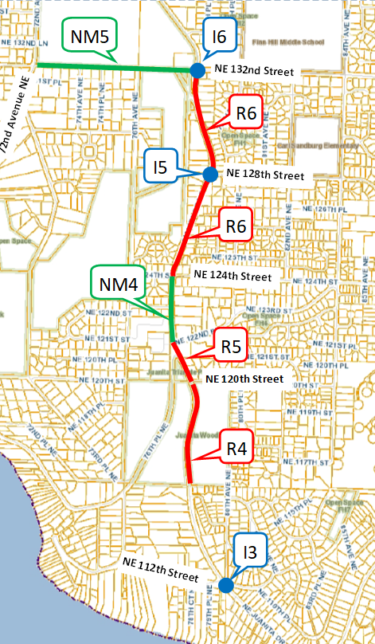
Design Update
ID | Location | Description | CIP #
I6 | NE 132nd St Intersection to NE 133rd Place | Left turn pocket/ pedestrian crossing/ walkway | STC 08900
I5 | NE 128th St Intersection | Left turn pocket/ pedestrian crossing | STC 08900
R6 | NE 124th St to NE 132nd St | Cross-section | STC 08900
NM4 | NE 124th St Intersection | Pedestrian Crossing/ walkway to NE 123rd St | NMC 09010
R5 | NE 120th St to NE 122nd Lane | Extend 3rd lane/ walkway on east side | STC0 8900
R4 | 79th Way NE to NE 120th St | Cross-section | NMC 12700
I3 | 112th Ave NE Intersection | Rechannelize Intersection/ Pedestrian Crossing | STC 08900
NM5 | NE 132nd St- Juanita Drive to 72nd Ave NE | Pedestrian/Bicycle Corridor treatment | NMC 09010

Slide 6
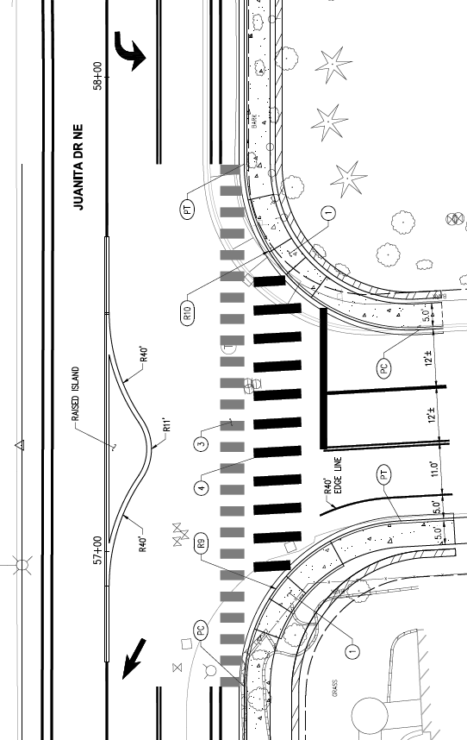
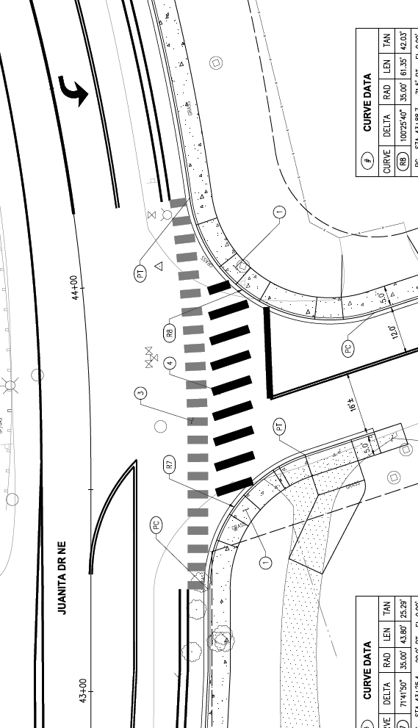
Design Update
New left turn lane
NE 132nd St & Juanita Dr NE and NE 128th St & Juanita Dr NE Intersections
Improved Access
Improved Safety
New left turn lane
Juanita Drive NE
NE 128th Street
NE 132nd Street
Juanita Drive NE
New crosswalk
New merge lane
New crosswalk

Slide 7
Design Update
Juanita Drive Area Map
NE 132nd Street to 79th Way NE
Nonmotorized connectivity
Continuous sidewalk and buffered bicycle lane on east side of Juanita Drive NE
Improved Safety
RRFB crosswalk at NE 124th Street across Juanita Drive NE
New RRFB Crosswalk
Continuous nonmotorized facilities

Slide 8
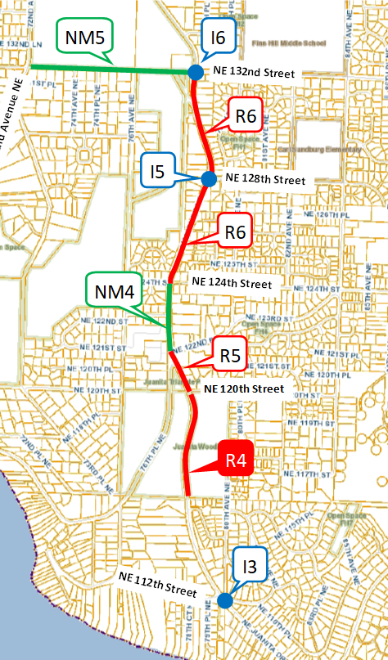
Design Opportunity
NE 120th Street to 79th Way NE
Received $650,000 Grant
Add sidewalk and bicycle lane on the east side of Juanita Drive
Proposed CIP Update moves from unfunded to funded

Slide 9
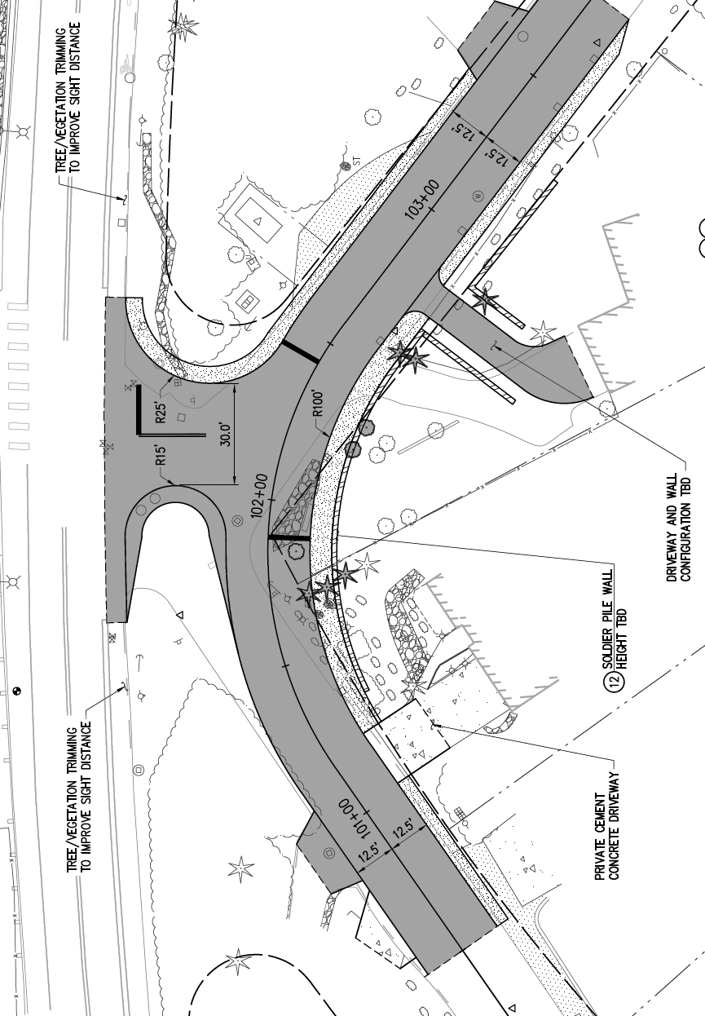
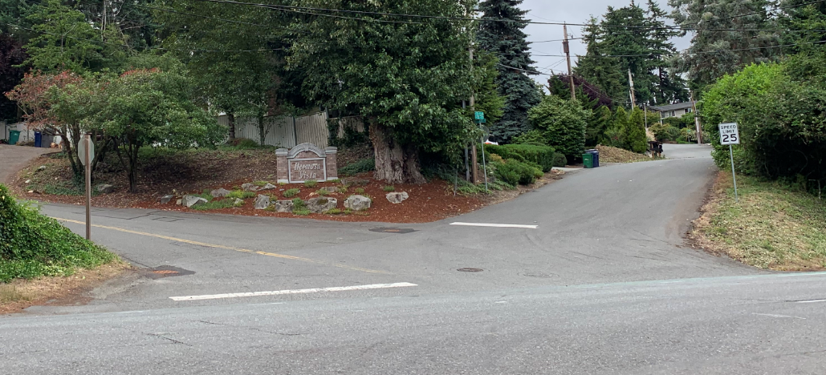
Design Update
Juanita Drive NE
80th Avenue NE
NE 112th St & 80th Ave NE Juanita Dr NE Intersection
Improved Access
Improved Safety
Vegetation Removal for Sight Distance
Proposed Right-Of-Way Acquisition
NE 112th Street

Slide 10
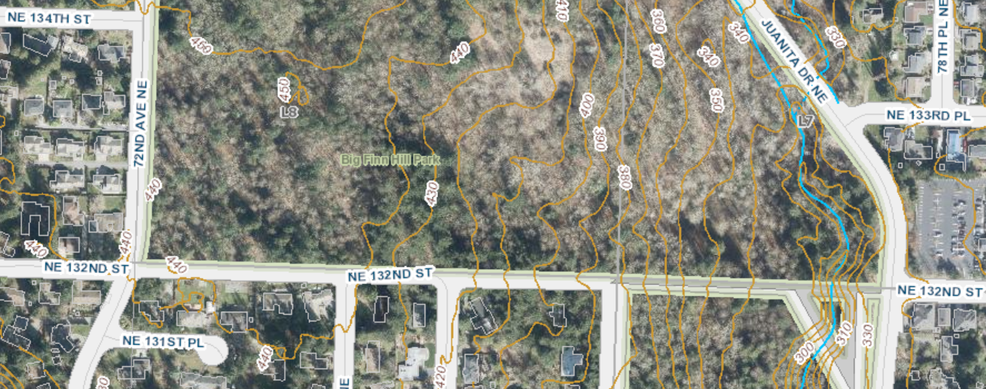
Design Update
NE 132nd Street – 72nd Ave NE to Juanita Dr NE
Nonmotorized Connectivity
Preliminary Engineering Only, Evaluating 3 Options

Slide 11
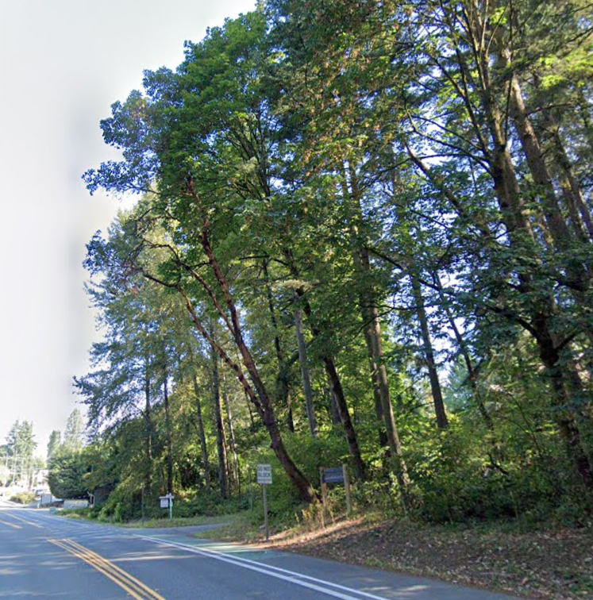
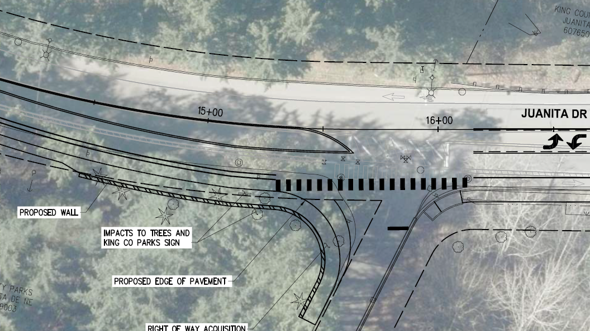
Design Considerations
Tree Removal and Right-Of-Way Acquisition
Tree Removals
Juanita Drive NE
Proposed Right-Of-Way Acquisition
NE 120th Street

Slide 12
Funding and Expected Expenses
 | Project Total
Grant Funds | $ 1,400,000
Local Funds | $ 1,836,000
Debt Funds | $ 4,755,200
Total Funds | $ 7,991,200
Proposed CIP Update | $ 1,957,000
Proposed Total Funds | $ 9,948,200
 | Project Total
Soft Costs | $ 3,982,200
Construction Costs | $ 5,955,000
Total Expected Expenses | $ 9,937,200

Slide 13
Schedule
City Council Meeting
Design
Construction

Slide 14
Next Steps
Progress Design to 60%, 90%, and Bid Ready
Return to Council for Award of Contract
Continuous Outreach Efforts

Slide 15
Questions?

